Slide 1
ThreatVision Training
Overview for Websense SEs
ThreatVision Hotfix
April 2013

Slide 2
ThreatVision Release Summary
Customers looking for a method to POC WSG / WSGA without deploying proxy
Competitive mode of operation
Helps to prove the advantages offered by Websense Content Gateway and the Websense ACE analytics
Customer Use Case drivers
Phase I – ThreatVision POC Tool
  Web Security Gateway (/Anywhere) running off a Span port
  POC-only tool for 7.7.3 code branch
  Full Support & SE Readiness program
  Minimal GTM
Phase II – Web Security Gateway ThreatVision (feature)
  Integration into Web Security Gateway (Anywhere) 7.8 in Production version
  Full GTM
Proposed Solution

Slide 3

ThreatVision POC Tool Release Goals
The Threat Vision POC Tool has three major corporate goals:
Turn POCs into larger and broader evaluations.
Provide real world data on the Span mode of operation
Provide early access to all Websense teams in readiness for a GA version.
The program has accomplished these business goals, to date. We will continue to seek your feedback to measure success.

Slide 4
Agenda
Objectives for this Overview course:
Capabilities: The Big Picture
Known limitations
Setup steps
How to obtain the patches and docs
Findings:
  Performance
  Known issues
  Caveats
How to provide feedback from the field

Slide 5
ThreatVision Capabilities
The Big Picture

Slide 6
The Big Picture
ThreatVision is a POC Hotfix for v7.7.3 WSG/A
Hotfix not available to customers. See internal KB article.
Requires SE setup
Applies to V10000 G2R2 and V10000 G3 only
V10000 G2R2 or G3 must be configured to monitor traffic using a span port.
Can be used with one Windows management & reporting server -- but separate SQL Server machine is recommended.
Uses standard Websense reporting tools

Slide 7
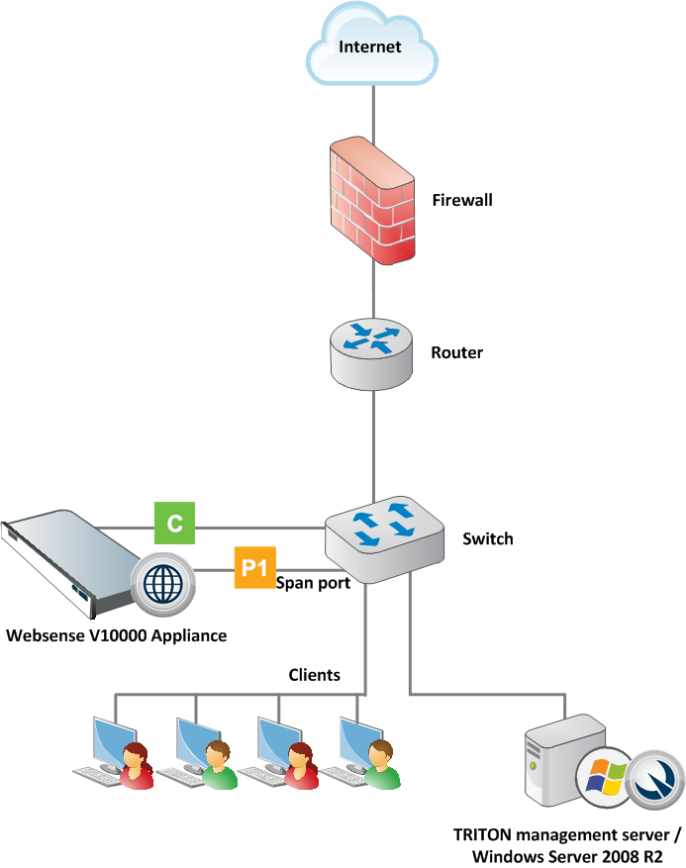
Topology

Slide 8
Capabilities
Traffic monitored by the ThreatVision POC tool is analyzed in real time by Content Gateway.
Results of the analysis are logged, and appear in Websense standard reports and Real-Time Monitor.
No requests are actually blocked.

Slide 9
Capabilities
If the administrator configures policies that include blocked categories, Web Security reporting tools show requests as blocked.
No actual blocking has occurred.

Slide 10
Capabilities
Admins can configure Web Security policies to find out (through reports) how the policies would be applied in enforcement mode.
Admins can configure suspicious activity alerts and usage alerts.

Slide 11
Known Limitations
ThreatVision POC Tool

Slide 12
Known Limitations (part 1 of 4)
Websense Content Gateway proxy authentication must not be enabled in ThreatVision POC deployments.
Disabling ThreatVision requires reimaging the appliance.
Only HTTP traffic is supported (not FTP or HTTPS).
SSL decryption is not available in this mode.

Slide 13
Known Limitations (part 2 of 4)
A single TRITON console cannot support both ThreatVision and enforcement mode appliances at the same time.
Network Agent protocol monitoring is not included at this time.
VLAN tagging is not supported.

Slide 14
Known Limitations (part 3 of 4)
If the admin sets up Web DLP policies that include blocking:
  Data Security incident reports show blocked requests (even though no actual blocking occurred).
  Web Security Real-Time Monitor shows the requests as permitted.
  Web Security investigative reports show the action applied to the requests as “Not Available” (neither permitted nor blocked).
  Note that the forensics repository does store files associated with Web DLP incidents.

Slide 15
Known Limitations (part 4 of 4)
In a standard Web Security Gateway deployment, if Filtering Service blocks a request based on its static (Master Database) category, the request does not go to Content Gateway for analysis.
In other words, even with aggressive scanning enabled, URLs are analyzed only if they are permitted by the initial Filtering Service lookup.
As a result of this standard behavior, when ThreatVision is enabled, if a policy “blocks” a request before the request is sent to the analytics, subsequent requests by the user for content internal to that website (for example, clicking through content on the site) may not appear in reports.
This happens because Content Gateway does not know that the “block” is virtual.
It acts as though a block page was sent, and closes its connection to the request.

Slide 16
ThreatVision Setup
Major Steps for ThreatVision Setup

Slide 17
Setup process overview
1. Set Up the Appliance
2. Create a Management Server
3. Configure ThreatVision
The Setup Guide walks you through all setup steps in detail.
If you prefer, you can follow the same steps in this slide deck.
Or, move forward to Slide 98 to see QA testing scope.

Slide 18
Topology

Slide 19
Setup process overview
Set Up the Appliance
Step 1: Set up the appliance hardware
Step 2: Run the firstboot script
Step 3: Configure basic appliance settings
Step 4: Configure network interfaces
Step 5: Configure Web Security component interaction
Step 6: Enable the ThreatVision hotfix

Slide 20
Set up the appliance > Hardware
Set Up the Appliance
Step 1: Set up the appliance hardware
The topology diagram above gives a simple overview of a ThreatVision deployment.
In addition to the V10000 G2 or G3 Appliance, a Windows Server 2008 R2 machine is required, to host management and reporting components.

Slide 21
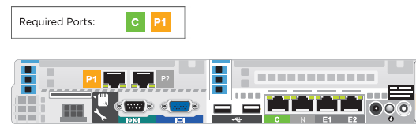
Set up the appliance > Hardware
Connect the C and P1 appliance interfaces
Only appliance ports C and P1 are used.
Network interface C provides communication for appliance modules and handles database downloads.
Interface C:
  Must be able to access a DNS server
  Has continuous access to the Internet
Ensure that interface C is able to access the download servers at download.websense.com. This URL must be permitted by all firewalls, proxy servers, routers, or host files controlling the URLs that the C interface can access.
Network interface P1 connects to a span port on the switch, to allow Websense Content Gateway to monitor client Internet requests.

Slide 22
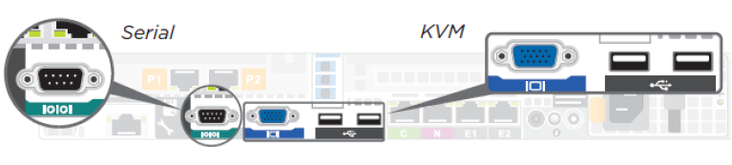
Set up the appliance > firstboot
Set Up the Appliance
Step 1: Set up the appliance hardware
Step 2: Run the firstboot script
After hardware setup, connect directly to the appliance through the serial port or the monitor and keyboard ports.

Slide 23
Set up the appliance > firstboot
An Activation script, called firstboot, runs when you start the appliance. The firstboot script prompts you to:
    Select the security mode for the appliance (Web)
    Supply settings for the network interface labeled C
    Enter a few other general items, such as hostname and password
You are given the opportunity to review and change these settings before you exit the firstboot script. After you approve the settings, the appliance mode is configured.
Later, if you want to change settings (except the security mode), you can do so through the Appliance Manager user interface.

Slide 24
Set up the appliance > firstboot
To change the security mode, re-image the appliance with the image from the Websense Downloads site, and then run the firstboot script again.
Gather the information on the following slide before running the script.

Slide 25
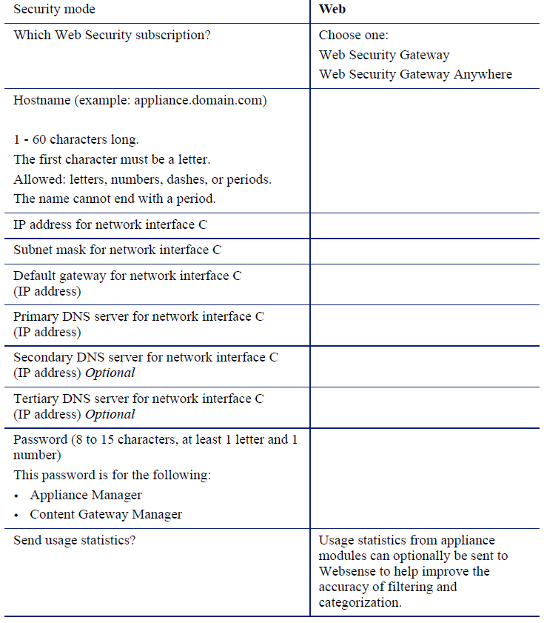
Set up the appliance > firstboot

Slide 26
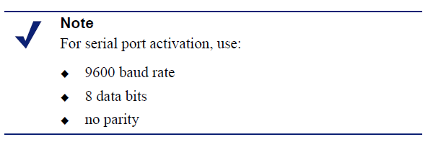
Set up the appliance > firstboot
Run the initial command-line configuration script (firstboot) as follows
Access the appliance through a USB keyboard and monitor, or a serial port connection.
Accept the subscription agreement when prompted.

Slide 27
Set up the appliance > firstboot
When asked if you want to begin, enter yes to launch the firstboot activation script.
  To rerun the script manually, enter the following command:
  firstboot
At the first prompt, select Web as the security mode.
Follow the on-screen instructions to provide the information collected in the table above.
After the script finishes running, continue with the next slide.

Slide 28
Set up the appliance > Configure basic settings
Set Up the Appliance
Step 1: Set up the appliance hardware
Step 2: Run the firstboot script
Step 3: Configure basic appliance settings
Appliance Manager is a Web-based interface for the appliance.
Use it to view system status, configure network and communication settings, and perform general appliance administration.

Slide 29
Set up the appliance > Configure basic settings
Open a supported browser (Internet Explorer 8 or 9, Firefox 5 and later, or Google Chrome 13 and later), and enter the following URL in the address bar:
https://<IP-address-of-C-interface>:9447/appmng
Log on with the user name admin and the password set during initial appliance configuration.
3. Use the navigation pane to go to the
Configuration > System page.

Slide 30
Set up the appliance > Configure basic settings
Under Time and Date:
    Use the Time zone list to select the time zone to be used on this system. GMT (Greenwich Mean Time), the default, is also known as UTC (Universal Time, Coordinated). Other time zones are calculated by adding or subtracting from GMT.
    Use the Time and date radio buttons to indicate how you want to set the date. Time is set and displayed using 24-hour notation.

Slide 31
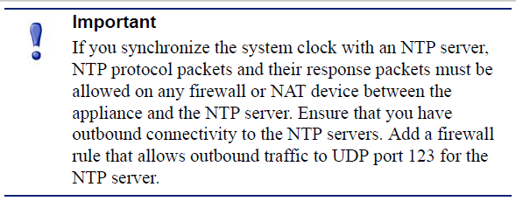
Set up the appliance > Configure basic settings
    To synchronize with an Internet Network Time Protocol (NTP) server (www.ntp.org.), select the Automatically synchronize option and enter the address of a primary NTP server. The secondary and tertiary fields are optional.
    To set the time yourself, select the Manually set option and change the value in the Date and Time fields. Use the format indicated below the entry field.

Slide 32
Set up the appliance > Configure basic settings
Create or edit a unique appliance description to help you identify and manage the system, particularly when there will be multiple appliances deployed. The description is displayed in the appliance list in the TRITON Unified Security Center when the appliance is added there.
Click OK to save your changes.

Slide 33
Setup process overview
Set Up the Appliance
Step 1: Set up the appliance hardware
Step 2: Run the firstboot script
Step 3: Configure basic appliance settings
Step 4: Configure network interfaces

Slide 34
Set up the appliance > Configure network interfaces
Still in Appliance Manager:
Navigate to the Configuration > Network Interfaces IPv4 and IPv6 pages.
Specify the IP address, subnet mask, default gateway, and DNS address for the P1 interface.
    Correct DNS settings are essential for the Web Security Monitor to function.
    While entries for the IP address, mask, and default gateway fields are required by the user interface, you can enter any valid settings. Because the NIC is used only for monitoring, the IP address settings are not functionally important.
Disable the P2 interface.

Slide 35
Set up the appliance > Configure network interfaces
IMPORTANT
Do not make configuration changes on the Network Interfaces pages after enabling ThreatVision.
After monitoring is enabled, changes to your NIC configuration will prevent the product from functioning correctly.

Slide 36
Setup process overview
Set Up the Appliance
Step 1: Set up the appliance hardware
Step 2: Run the firstboot script
Step 3: Configure basic appliance settings
Step 4: Configure network interfaces
Step 5: Configure Web Security component interaction

Slide 37
Set up the appliance > Configure Web Security components
Still in Appliance Manager:
Navigate to the Configuration > Web Security Components page to specify which Web Security components are active on the appliance, and where the appliance gets Web Security global configuration and Internet access policy information.
Under Policy Source, select Full policy source.
  This means that it hosts Websense Policy Broker, which is responsible for global configuration and policy management information.
Click OK to save and apply your changes.
Under TRITON - Web Security, specify that the TRITON console is installed Off the appliance (on a separate Windows machine).
Click OK to save and apply your changes.

Slide 38
Setup process overview
Set Up the Appliance
Step 1: Set up the appliance hardware
Step 2: Run the firstboot script
Step 3: Configure basic appliance settings
Step 4: Configure network interfaces
Step 5: Configure Web Security component interaction
Step 6: Enable the ThreatVision hotfix
To enable ThreatVision, obtain the hotfix from the Internal KB article and move it to your local network.

Slide 39
Set up the appliance > Apply the hotfix and enable ThreatVision
To enable ThreatVision, upload the hotfix to the appliance and enable it with these steps:
Open Appliance Manager in a supported browser. The URL is:
https://<IP-address-of-C-interface>:9447/appmng
Navigate to the Administration > Patches / Hotfixes > Hotfixes page.
Click Upload Hotfix Manually to retrieve the hotfix file from a network location.
Click Install to initiate hotfix installation.
Wait until hotfix application is complete.

Slide 40
Set up the appliance > Apply the hotfix and enable ThreatVision
Connect the appliance P1 interface to a span port on the switch that mirrors the client traffic you want to monitor.
Use SSH to connect to the appliance C interface and log on using your Appliance Manager logon credentials when prompted.
Enter the following command:
monitor enable
Close the SSH session, then use SSH to open a new connection to the appliance C interface.

Slide 41
Set up the appliance > Apply the hotfix and enable ThreatVision
To verify that the appliance has successfully enabled monitor mode, enter the following command:
monitor status
  If the status does not show that monitor mode has been enabled, you may need to restart the appliance and try again.
After enabling monitor mode, apply any new hotfixes listed in the ThreatVision KB article.
Then, create a TRITON management server.

Slide 42
Setup process overview
1. Set Up the Appliance
2. Create a Management Server
3. Configure ThreatVision
The Setup Guide walks you through all setup steps in detail.

Slide 43
Setup process overview
Create a Management Server
Step 1: Download the installer and start installation
Step 2: Install TRITON Infrastructure
Step 3a: Install Web Security management components
Step 3b (optional): Install Data Security management components
Step 4: Enter a key and download the Master Database

Slide 44
Create Management Server > Run the installer
Step 1: Download the installer and start installation
Download the Websense Web Security Gateway - Windows installer from the Downloads tab of mywebsense.com.
  The file name is WebsenseTRITON773Setup.exe.
  The version is 7.7.3.
  When extracted, the installation files occupy about 2 GB of disk space.

Slide 45
Create Management Server > Run the installer
Double-click the installer executable to launch the Websense TRITON Setup program.
A progress dialog box is displayed as files are extracted. This may take a few minutes.
On the Welcome screen, click Start.
On the Subscription Agreement screen, select I accept this agreement and then click Next.

Slide 46
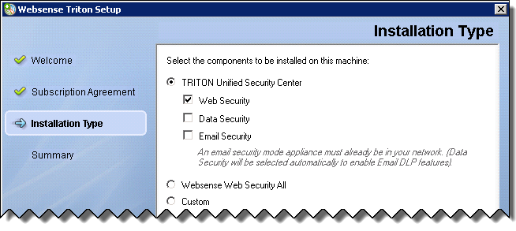
Create Management Server > Run the installer
For Web Security Gateway: Mark the Web Security check box.

Slide 47
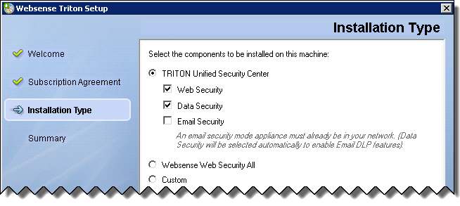
Create Management Server > Run the installer
For Web Security Gateway Anywhere: Mark the Web Security and Data Security check boxes.

Slide 48
Create Management Server > Run the installer
When you are finished, click Next.
On the Summary screen, click Next to continue the installation.
The TRITON Infrastructure Setup program launches. Continue with the next slide.

Slide 49
Create Management Server > Infrastructure
Create a Management Server
Step 1: Download the installer and start installation
Step 2: Install TRITON Infrastructure
TRITON Infrastructure is the platform on which Websense TRITON management components are built. When the infrastructure components have been installed, the Web Security installer launches automatically to install the Web Security management
components.

Slide 50

Create Management Server > Infrastructure
On the TRITON Infrastructure Setup Welcome screen, click Next.
On the Installation Directory screen, specify the location where you want TRITON Infrastructure to be installed and then click Next.
On the SQL Server screen, specify the location of your database engine and the type of authentication to use for the connection. Also specify whether to encrypt communication with the database.

Slide 51
Create Management Server > Infrastructure
Select Use existing SQL Server on this machine if the Websense installer has already been used to install SQL Server 2008 R2 Express on this machine.
Select Install SQL Server Express on this machine to install SQL Server 2008 R2 Express on this machine.
When this option is selected, .NET 3.5 SP1, Powershell 1.0, and Windows Installer 4.5 are installed automatically if they are not found on the machine. These are required for SQL Server 2008 R2 Express.

Slide 52
Create Management Server > Infrastructure
A default database instance named mssqlserver is created, by default. If a database instance with the default name already exists on this machine, an instance named TRITONSQL2K8R2X is created instead.
In some cases, you are prompted to reboot the machine after installing SQL Server Express. If you do, go to Start > All Programs > Websense > Websense TRITON Setup to restart the installer.

Slide 53
Create Management Server > Infrastructure
Select Use existing SQL Server on another machine to specify the location and connection credentials for a database server located elsewhere in the network.
Enter the Hostname or IP address of the SQL Server machine, including the instance name, if any.
    If you are using a named instance, the instance must already exist.
    If you are using SQL Server clustering, enter the virtual IP address of the cluster.
    Also provide the Port used to connect to the database (1433, by default).

Slide 54
Create Management Server > Infrastructure
After selecting one of the above options, specify an authentication method and account information:
Select the Authentication method to use for database connections: SQL Server Authentication (to use a SQL Server account) or Windows Authentication (to use a Windows trusted connection).
Next, provide the User Name or Account and its Password. This account must be configured to have system administrator rights in SQL Server. If you are using SQL Server Express, sa (the default system administrator account) is automatically specified (this is the default system administrator account).

Slide 55
Create Management Server > Infrastructure
When you click Next, connection to the database engine is verified. If the connection test is successful, the next installer screen appears.
If the test is unsuccessful, the following message appears:
Unable to connect to SQL
Make sure the SQL Server you specified is currently running. If it is running, verify the access credentials you supplied.
Click OK to dismiss the message, verify the information you entered, and click Next to try again.

Slide 56
Create Management Server > Infrastructure
On the Server & Credentials screen, select the IP address of this machine and specify network credentials to be used by TRITON Unified Security Center.
  Select an IP address for this machine. If this machine has a single network interface card (NIC), only one address is listed.
  Specify the Server or domain of the user account that you want to use to run the TRITON Infrastructure and TRITON Unified Security Center services. The server/host name cannot exceed 15 characters.

Slide 57
Create Management Server > Infrastructure
  Specify the User name of the account that you want to use to run the TRITON Unified Security Center services.
  Enter the Password for the specified account.
On the Administrator Account screen, enter an email address and password for the default TRITON console administration account: admin. When you are finished, click Next.
System notification and password reset information is sent to the email address specified (once SMTP configuration is done; see next step).
Define a strong password as described on the screen.

Slide 58
Create Management Server > Infrastructure
On the Email Settings screen, enter information about the SMTP server to be used for system notifications and then click Next. You can also configure these settings after installation in the TRITON console.
  IP address or hostname: IP address or host name of the SMTP server through which email alerts should be sent. In most cases, the default Port (25) should be used. If the specified SMTP server is configured to use a different port, enter it here.
  Sender email address: Originator email address appearing in notification email.

Slide 59
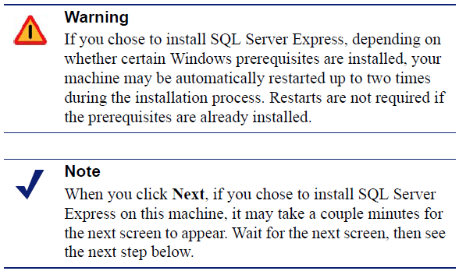
Setup process overview
  Sender name: Optional descriptive name that can appear in notification email. This is can help recipients identify this as a notification email from the TRITON Unified Security Center.
On the Pre-Installation Summary screen, verify the information and then click Next to begin the installation.

Slide 60
Create Management Server > Infrastructure
If you chose to install SQL Server Express, .NET Framework 3.5 SP1, PowerShell 1.0, and Windows Installer 4.5 will be installed if not already present. Wait for Windows to configure components.
  If the following message appears during this process, click OK:
  Setup could not restart the machine. Possible causes are insufficient privileges, or an application rejected the restart. Please restart the machine manually and setup will restart.

Slide 61
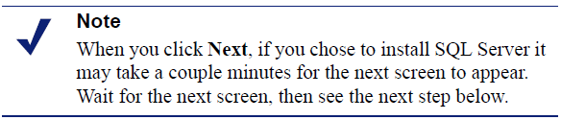
Create Management Server > Infrastructure
  Websense installer starts again. In the TRITON Infrastructure Setup Welcome screen, click Next.
  The Ready to Resume EIP Infra installation screen appears. Click Next.

Slide 62
Create Management Server > Infrastructure
If you chose to install SQL Server Express on this machine, SQL Server 2008 R2 Setup is launched. Wait for it to complete.
The Setup Support Files screen appears, and then an Installation Progress screen appears. Wait for these screens to complete automatically. It is not necessary to click or select anything in these screens.
Note that it may take approximately 10-15 minutes for the SQL Server 2008 R2 Express installation to complete.

Slide 63
Create Management Server > Infrastructure
Next, the Installation screen appears. Wait until all files have been installed.
  If the following message appears, check whether port 9443 is already in use on this machine:
  Error 1920. Server 'Websense TRITON Central Access‘ (EIPManagerProxy) failed to start. Verify that you have sufficient privileges to start system services.
  If port 9443 is in use, release it and then click Retry to continue installation.

Slide 64
Create Management Server > Infrastructure
On the Installation Complete screen, click Finish.
  The TRITON Infrastructure Setup program closes, and the Web Security component installer launches. Continue with the next slide.

Slide 65
Setup process overview
Create a Management Server
Step 1: Download the installer and start installation
Step 2: Install TRITON Infrastructure
Step 3a: Install Web Security management components
On the Select Components screen, select the following components to install, and then click Next.
  TRITON - Web Security
  Web Security Log Server
  Web Security Gateway Anywhere only (optional): Sync Service

Slide 66
Create management server > Web components
  Web Security Gateway Anywhere only: Linking Service
  Real-Time Monitor
On Policy Server Connection screen, enter the IP address and port used by Policy Server (the IP address of the appliance C interface and 55806, by default).
When you are finished, click Next.
If you selected Sync Service for installation, use the Policy Broker Connection screen to enter the IP address and port used by Policy Broker (the IP address of the appliance C interface and 55880, by default).
When you are finished, click Next.

Slide 67
Create management server > Web components
Use the Log Database Location screen to specify the IP address or hostname of the SQL Server instance that will host the Log (reporting) Database (if necessary), and provide a path for the database files.
  When finished, click Next.
On the Optimize Log Database Size screen, select Log Web page visits.
  This results in fewer log records for each URL by combining information for secondary elements on a website (like graphics) into a single record. This results in smaller databases, allowing for potentially faster report generation and longer storage capacities. When finished, click Next.

Slide 68
Create Management server > Web components
If you selected Linking Service for installation, on the Filtering Service Communication screen, provide the IP address and port used by Filtering Service (the IP address of the appliance C interface and 15868, by default).
  When finished, click Next.
On the Pre-Installation Summary screen, verify the information shown.
  The summary shows the installation path and size, and the components to be installed.

Slide 69
Create Management server > Web components
Click Next to start the installation. The Installing Websense progress screen is displayed. Wait for installation to complete.
On the Installation Complete screen, click Next.
For Web Security Gateway, installation of off-appliance components is complete. Continue with Step 4: Enter a key and download the Master Database.
For Web Security Gateway Anywhere, continue with the Step 3b, Install Data Security management components.

Slide 70
Setup process overview
Create a Management Server
Step 1: Download the installer and start installation
Step 2: Install TRITON Infrastructure
Step 3a: Install Web Security management components
Step 3b (optional): Install Data Security management components
When the Data Security component installer launches, and the Welcome screen is displayed click Next.

Slide 71
Create Management server > Data components
On the Select Components screen, accept the defaults and click Next.
If prompted, click OK to accept that services such as ASP.NET and SMTP will be enabled.
On the Fingerprinting Database screen, accept the default location or click Browse to specify a different location (local path only).
If your SQL Server database is on a remote machine, use the Temporary Folder Location Screen to provide the name of a folder to use for temporary files created during archive processing and system backup and restore. Also indicate:

Slide 72
Create Management server > Data components
Whether to Enable incident archiving and system backup to archive old or aging incidents and perform system backup or restore.
Use the From SQL Server field to enter the UNC path that the SQL Server should use to access the temporary folder. Make sure the account used to run SQL has write access to this folder.
Use the From TRITON Management Server field to enter the UNC path the management server should use to access the temporary folder. Enter a user name and password for a user who is authorized to access this location

Slide 73
Create Management server > Data components
In the Installation Confirmation screen, click Install to begin installing Data Security components.
If the following message appears, click Yes to continue the installation:
Data Security needs port 80 free. In order to proceed with this installation, DSS will free up this port. Click Yes to proceed OR click No to preserve your settings.
A similar message for port 443 may appear. Click Yes to continue.

Slide 74
Create Management server > Data components
The Installation progress screen appears. Wait for the installation to complete.
When the Installation Complete screen appears, click Finish to close the Data Security installer.
You have completed installation of the TRITON management server. Continue with the next slide to enter a subscription key and activate your Web Security software.

Slide 75
Setup process overview
Create a Management Server
Step 1: Download the installer and start installation
Step 2: Install TRITON Infrastructure
Step 3a: Install Web Security management components
Step 3b (optional): Install Data Security management components
Step 4: Enter a key and download the Master Database
After the management server installation is complete, log on to the TRITON console and enter your Web Security Gateway subscription key.

Slide 76
Create management server > Enter subscription key
Open a supported browser (Internet Explorer 8 or 9, Firefox 5 and later, or Google Chrome 13 and later), and enter the following URL in the address bar:
https://<IP-address-of-management server>:9443/triton/
Enter the user name admin and the password set during installation, then click Log On.
  You are logged on to the TRITON console and automatically connected to the Web Security management module.

Slide 77
Create management server > Enter subscription key
A pop-up window prompts you to enter your subscription key. If Internet requests originating from the appliance C interface must go through a proxy to reach the Internet, provide the proxy details at the same time you enter the key, and before clicking OK.
Go to the System tab of the Status > Dashboard page to monitor the progress of the Master Database download.
When the download is complete, log off of the TRITON console and continue with the next step.

Slide 78
Setup process overview
Configure ThreatVision
Step 1: Configure Content Gateway analysis
Step 2a: Customize Internet access policies
Step 2b(optional): Configure Web DLP policies
Step 3: Configure reporting behavior
Step 4(optional): Configure the monitor port

Slide 79
Configure ThreatVision > Content Gateway analysis
Step 1: Configure Content Gateway analysis
This section describes which analysis options to enable to best demonstrate the capabilities offered by Content Gateway and its analytics. Note, however, that even in this configuration, not all traffic may be sent to the proxy for analysis.
If any policies that you configure (including the Default policy) use only the Monitor Only filters, all traffic will go to the proxy, but reports will not show any blocked requests.
This means that you will not be able to see the blocking capabilities of the full (enforcement mode) solution.

Slide 80
Configure ThreatVision > Content Gateway analysis
If your policies enforce filters that block categories (as instructed in the nextsection), any requests blocked before analysis (that is, any requests for URLs assigned to Master Database categories blocked by the filter) are not forwarded to the proxy (just as in enforcement mode).
In other words, even though no actual block occurs, the request is treated as if it had been blocked based on Master Database categorization, and no further analysis is performed.
This mirrors the way that Web Security Gateway (Anywhere) functions in enforcement mode.

Slide 81
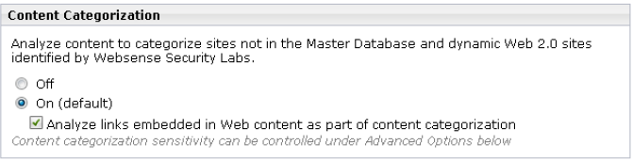
Configure ThreatVision > Content Gateway analysis
To configure how Content Gateway analyzes traffic:
Log on to the TRITON console as admin, using the password created during installation and select the Web Security module (if needed).
Select the Settings tab of the left navigation page, then navigate to the Scanning > Scanning Options page.
Under Content Categorization, make sure that the On radio button is selected, and that the Analyze links embedded in Web content... check box is marked.

Slide 82
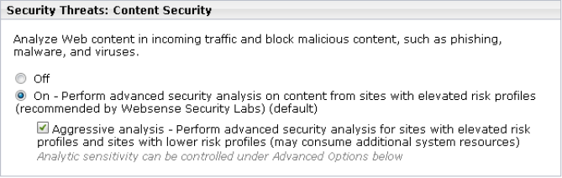
Configure ThreatVision > Content Gateway analysis
Under Tunneled Protocol Detection, make sure that the On radio button is selected.
Under Security Threats: Content Security, make sure that the On radio button is selected, and the Aggressive analysis... check box is marked.

Slide 83
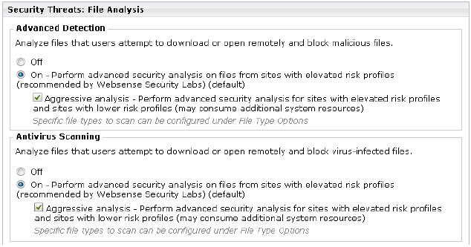
Configure ThreatVision > Content Gateway analysis
Under Security Threats: File Analysis:
Under Advanced Detection, make sure that the On radio button is checked, and the Aggressive analysis... check box is marked.
Under Antivirus Scanning, make sure that the On radio button is checked, and the Aggressive analysis... check box is marked.

Slide 84
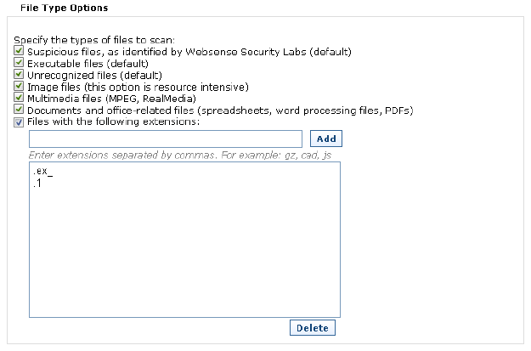
Configure ThreatVision > Content Gateway analysis
Expand the File Type Options button, then mark all of the file type check boxes.

Slide 85
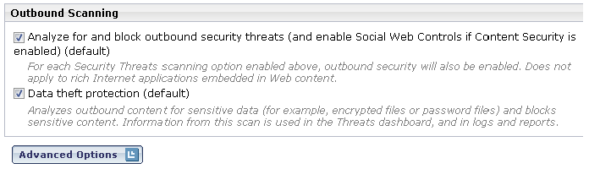
Configure ThreatVision > Content Gateway analysis
Under Outbound Scanning, make sure that both the Analyze for and block outbound security threats... and Data theft protection check boxes are marked.
Click OK to cache your changes, then click Save and Deploy to implement them.
Next, optionally customize your Web Security policies.

Slide 86
Setup process overview
Configure ThreatVision
Step 1: Configure Content Gateway analysis
Step 2a: Customize Internet access policies
With ThreatVision, creating custom policies enables reporting tools to show how requests would be handled by Websense Web Security Gateway (Anywhere) in enforcement mode. Regardless of how strict the policies are that you create, no requests are blocked while the deployment is in monitor mode.

Slide 87
Configure ThreatVision > Customize Internet policies
Web Security Gateway includes a Default policy, in effect 24 hours a day, 7 days a week. This policy is applied to all requests from clients that do not have any other policy assigned. Initially, this policy is configured to use the Monitor Only category filter, which permits all Internet requests.
As a best practice, configure the Default policy to enforce the Basic category filter, then update the filter to block 4 additional categories, as described below:
In the Web Security module of the TRITON console, navigate to the Policy Management > Policies page.

Slide 88
Configure ThreatVision > Customize Internet policies
Click the Default link to open the Default policy for editing.
Expand the Category / Limited Access Filter list and select Basic.
The Category Filter box (under the Policy Definition box) updates to show which categories the Basic category filter blocks and permits.
Scroll down to the Extended Protection parent category in the category list and expand it to see its child categories.
Select Dynamic DNS, then click Block.
Scroll down to the Productivity parent category and expand it, then select Freeware and Software Download and click Block.

Slide 89
Configure ThreatVision > Customize Internet policies
Scroll down to the Security parent category and expand it, then:
    Select Malicious Embedded Link and click Block.
    Select Suspicious Embedded Link and click Block.
Click OK to cache your changes, then click Save and Deploy to implement them. In addition to modifying the Default policy, you can:
    Create additional, custom policies.
    Define specific clients (IP addresses or IP address ranges) and apply different policies to different clients or groups of clients.

Slide 90
Setup process overview
Configure Monitor Mode
Step 1: Configure Content Gateway analysis
Step 2a: Customize Internet access policies
Step 2b (optional): Configure Web DLP policies
If you have installed Websense Web Security Gateway Anywhere, configure Web DLP policies in the Data Security manager to compliment your Web Security policies.
Select the Data Security module of the TRITON console.

Slide 91
Configure ThreatVision > Configure Web DLP policies
On the Main tab, navigate to the Policy Management > DLP Policies > Web DLP Policy page. A quick-start Web DLP policy is provided.
On the Attributes tab, select and enable the attributes to monitor—for example uploaded file type. Configure properties for those attributes. When the settings you configure are matched, the policy is triggered.
See the Data Security Help for instructions.

Slide 92
Configure ThreatVision > Configure Web DLP policies
Select the Destination tab, then specify the websites where you do not want your data sent. See the Data Security Help for instructions.
Select the Policy Owners tab, then identify an owner for the policy. See the Data Security Help for instructions.
Click OK.

Slide 93
Setup process overview
Configure ThreatVision
Step 1: Configure Content Gateway analysis
Step 2a: Customize Internet access policies
Step 2b (optional): Configure Web DLP policies
Step 3: Configure reporting behavior
To record detailed information about the URLs that users request, enable full URL logging.

Slide 94
Configure ThreatVision > Configure reporting
In the Web Security module of the TRITON console, navigate to the Settings > Reporting > Log Database page.
Scroll down to the Full URL Logging section.
Select the Record domain and full URL of each site requested radio button.
Click OK to cache your changes, then click Save and Deploy to implement them.

Slide 95
Setup process overview
Configure ThreatVision
Step 1: Configure Content Gateway analysis
Step 2a: Customize Internet access policies
Step 2b (optional): Configure Web DLP policies
Step 3: Configure reporting behavior
Step 4 (optional): Configure the monitor port
If you want to monitor traffic on a port other than the default (port 80), configure the custom port in Content Gateway Manager:

Slide 96
Configure ThreatVision > Configure monitor port
Log on to Content Gateway Manager.
Select the Configure tab and navigate to the Networking > ARM page.
Click Edit File.
In the selection box at the top of the page, select the connection that you want to change (the rule using port 80).
Change the Destination Port value to the port you want to use.
Click Apply, then click Close to return to the ARM page.
Click Apply again to implement the change.

Slide 97
Configure ThreatVision
This completes the setup and configuration steps.

Slide 98
QA
Testing scope

Slide 99
QA Testing Boundaries
  The following were not tested by QA for v7.7.3:
    Co-existence with another proxy
    Network tap
    Monitor mode with Network Agent
    Tagged VLAN support (not officially supported, script available in Merlin build, tested by DEV in-house & on EAP customer deployment – to be used as last resort)

Slide 100
Performance and Stability Findings
Performance Engineering

Slide 101
Performance results at a glance
The ratio of ThreatVision observed concurrent connections to actual concurrent connections should not exceed 7.
These values represent the outermost boundary of the Performance Trade-Off Curve :
  Packet loss will exceed 10% if TPS exceeds 1100 and concurrent connections exceeds 2300.
  Packet loss will exceed 10% if concurrent connections exceeds 19500 and TPS exceeds 50.
  Packet loss will exceed 10% if TPS exceeds 1050 and concurrent connections exceeds 5300.
  Packet loss will exceed 10% if concurrent connections exceeds 13000 and TPS exceeds 575.

Slide 102
Performance results at a glance
Avoid the following settings, or risk significant loss of traffic:
  Max_nat_entries less than 10000
  Max_nat_entries more than 10000 (for V10000 G2R2) due to WCG crashing
  850 TPS or more when Aggressive Analysis is used
Our results show 120 hours of uninterrupted runtime at 850 TPS.
We pad payloads when missed packets happen. You would see this padding in /var/log/messages in this way:
[281067.836797] PADDED SESSION 17198019: 72.167.18.237(80) <= 172.18.200.100(35159), transaction id 1, text GET /gds1-36.crl HTTP/1.1

Slide 103
Performance results at a glance
More Likely to Miss Transactions with:
  Bursts of transactions or small packet delays (near 0ms) due to absence of flow control
  More transactions per connection (aka keep-alives) (easier to miss transactions by ASM)

Slide 104
Performance results at a glance
  Optimal TPS with high conns: 575 TPS with 11200 connections

Slide 105
Beta Program Summary

Slide 106
Beta Summary
4 Beta Sites were deployed + Internal Deployment
External customers:
  PDLC (Hong Kong)
  DataWorld (Hong Kong)
  Judicial Yuan (Taiwan)
  ShinKong Bank (Taiwan)
5 CRs logged from Beta (2 – Bs, 3 – Cs)
Notes:
Instructions on this slide:
This template is for each team to highlight what it is they need to do to deliver to the overall program. It is not meant to be detailed, but enough to highlight your team understand and know what needs to be done highlight they major things your team needs to build, share with other teams, schedule to get it done (aligned with Master Schedule). Each team is expected that they will manage the details of your teams tasks on a daily / weekly basis, and communicate as necessary when things are going to impact the major deliverables and thus program schedule. Attempt to keep one slide but you can do 2 if necessary. Please check all your formatting and spelling to overall slide deck.
Summarize how various teams contribute to the development of this project. How are you going to ensure you hit targets and work with cross product teams (alignment)
Examples:
Work break out between different sites
Partnerships
Team used prototyping and performance testing early on to make architectural decisions
One Sprint to develop full image with the features and then patch will be developed – using binary comparison method for equivalence
Functional specs and solution architecture specifications will drive the development efforts.
Detail design specifications to be created and reviewed by the broader team
Team members experienced from prior release
UI mockups, logos, and documentation will be produced by SD UX and Tech Comm Team
Improve Internal Beta Plan – More Formal testing and analysis
More automation to streamline testing effort (move to QA)

Slide 107
Beta Summary
4 Beta Sites were deployed + Internal Deployment
External customers:
  PDLC (Hong Kong)
  DataWorld (Hong Kong)
  Judicial Yuan (Taiwan)
  ShinKong Bank (Taiwan)
5 CRs logged from Beta (2 – Bs, 3 – Cs)
Notes:
Instructions on this slide:
This template is for each team to highlight what it is they need to do to deliver to the overall program. It is not meant to be detailed, but enough to highlight your team understand and know what needs to be done highlight they major things your team needs to build, share with other teams, schedule to get it done (aligned with Master Schedule). Each team is expected that they will manage the details of your teams tasks on a daily / weekly basis, and communicate as necessary when things are going to impact the major deliverables and thus program schedule. Attempt to keep one slide but you can do 2 if necessary. Please check all your formatting and spelling to overall slide deck.
Summarize how various teams contribute to the development of this project. How are you going to ensure you hit targets and work with cross product teams (alignment)
Examples:
Work break out between different sites
Partnerships
Team used prototyping and performance testing early on to make architectural decisions
One Sprint to develop full image with the features and then patch will be developed – using binary comparison method for equivalence
Functional specs and solution architecture specifications will drive the development efforts.
Detail design specifications to be created and reviewed by the broader team
Team members experienced from prior release
UI mockups, logos, and documentation will be produced by SD UX and Tech Comm Team
Improve Internal Beta Plan – More Formal testing and analysis
More automation to streamline testing effort (move to QA)

Slide 108
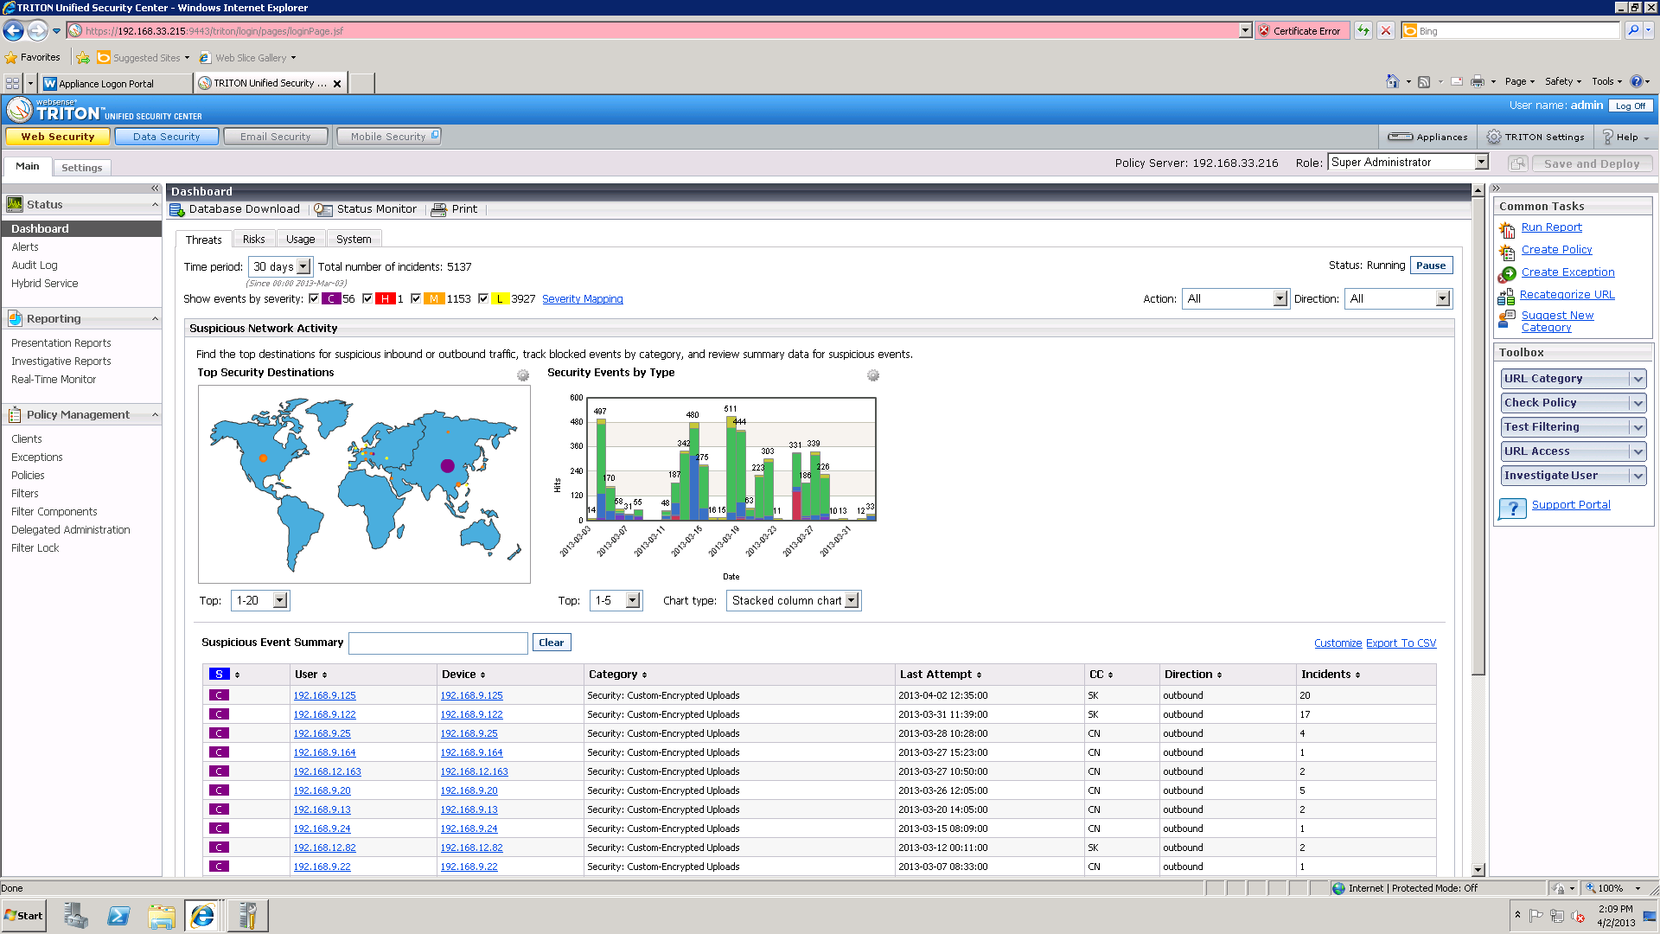
Threat Dashboards from Beta Sites (DataWorld)

Slide 109
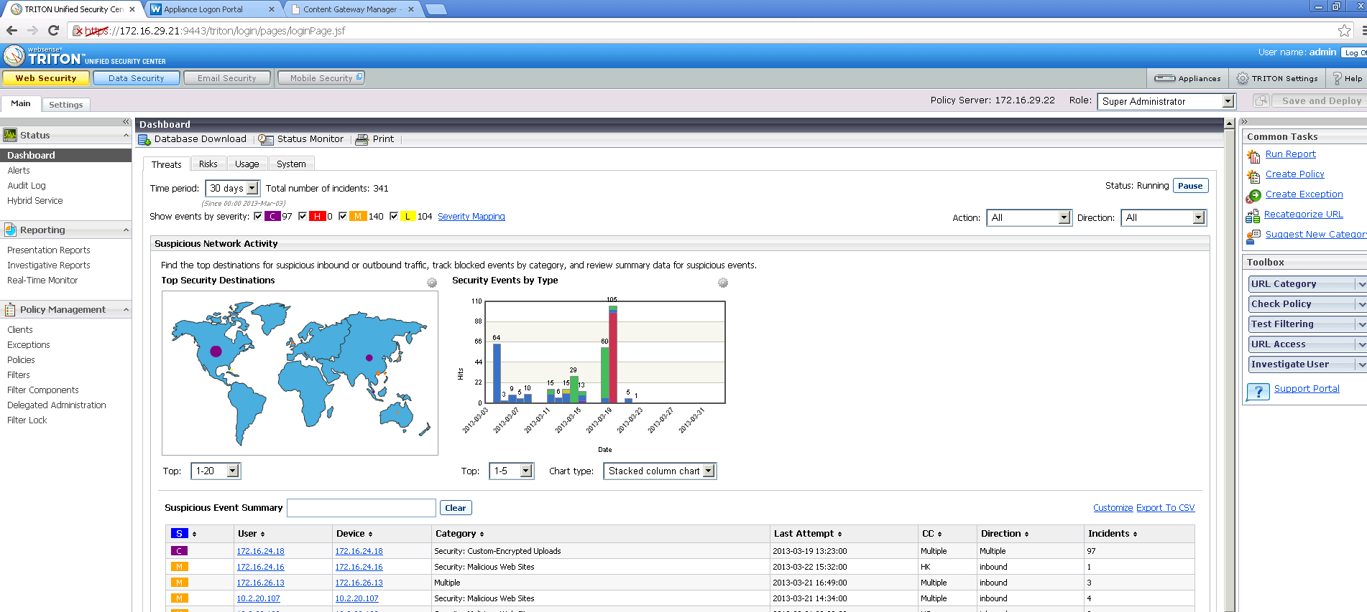
Threat Dashboards from Beta Sites (PDCL)

Slide 110
Support

Slide 111
Support Readiness
Technical Support will be prepared in late April to open cases in SFDC for ThreatVision.
In the meantime, contact Support and request an EI for escalation to Engineering, if an SFDC case cannot be opened at the time of your call.

Slide 112
Release Overview

Slide 113
SE - User Assistance
ThreatVision Setup Guide created for v7.7.3
The hotfix and setup guide are available via an internal KB article.
  KB Article will be updated as new information or field issues arise.
  A separate internal KB article (linked) hosts the fix that addresses a potential logging issue.

Slide 114
Go to Market

Slide 115
Released in April 2013
Internal SE and Partner Training slides
Tech Alert (Internal) announcement
  Links to separate internal KB article with any related hotfixes
  Provided to TS, SEs, PM by TS Operations
PMM has alerted Sales and Marketing managers

