Slide 1
7.7 New features
Abdurrahman Beyazaslan, Sr.SE

Slide 2
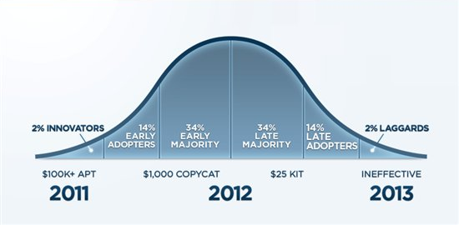
Malware Adoption Lifecycle

Slide 3

10 New Defense Levels in ACE
New ACE Analytics/Defenses:
Advanced Malware Payloads ←
Potentially Exploited Documents ←
Mobile Malware ←
Criminal Encrypted Uploads →
Files Containing Passwords →
Advanced Malware Command & Control →
Unauthorized Mobile Marketplaces →
OCR (Optical Character Recognition) →
Behavioral (Drip) DLP →
Geo-Location →
INBOUND
WSG
Advanced
Classification Engine
Predictive
Inline
Analytical
Engine
OUTBOUND
WSG
OUTBOUND
WSGA

Slide 4
WSGA v7.7 Feature Overview
Dashboard/Logging/Reporting
  Advanced Malware Protection
  Data Theft Protection
  SIEM Integration
  Trend Reports, Browse Time Reports, Reports by Web Property
Filtering and Policies
  Stateful Filtering
  Policy Exceptions
Proxy and NA
  WCCP Enhancements
  ICAP Support
  Headers for YouTube/Gmail
  VLAN support in NA
Federal Requirements
  IPv6 support
  Common Access Card (CAC) – Two-factor authentication

Slide 5
DSS v7.7 Feature Overview
Architectural changes
  Encryption for system data
  TCP port changes
Policies & classifiers
  Reg. & compliance rules
  Improved images classifier
  Data-theft classifiers for Web DLP
  Stateful DLP
  Replicate fingerprints to other networks
  Machine-learning
  OCR for images in-transit
Resources
  Country I.D. for geo-location
Agent features
  Mobile DLP
  SMTP bypass for encryption
Endpoints
  Mac OS Support
  New extractor for .xlsx & .docx
  Local discovery on Linux
Incidents/reporting
  Action links in email

Slide 6
ESGA 7.7 New Feature List
Administrator Accounts
  Granular role-based quarantine administrator
Policy Management
  Embedded URL policy/rule enhancements
  Virtual IP
  Content Guardian
  Delay Message Delivery
Cloud Email Security
  Cloud dashboard elements
  Consolidated Logging and Reporting in Hybrid mode
Logging & Reporting
  Show % URL contained in Email dashboard elements
Personal Email Management
  Central quarantine search – search over ALL quarantine.
  Multiple quarantined mailboxes management within PEM (previously had to log into various domains to access PEM for various e-mail accounts)

Slide 7
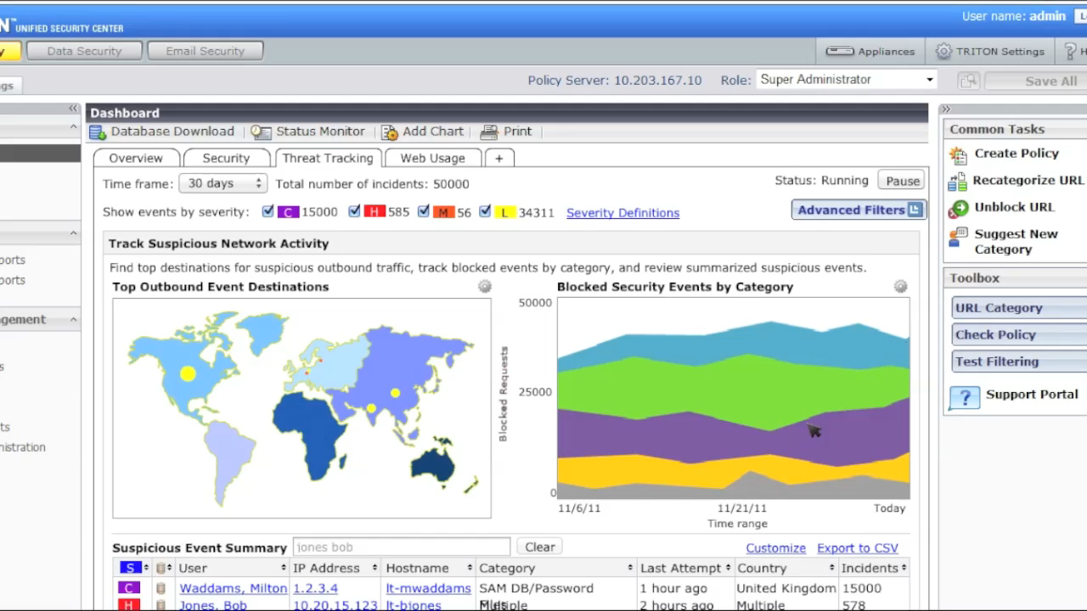
Threat Dashboard
7

Slide 8
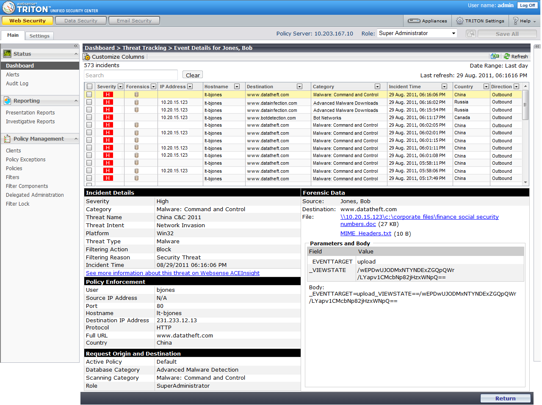
Advanced Malware Forensic Reporting
Know WHO was compromised
Know HOW the malware operates (intent)
Know WHERE the data was being sent
Know WHAT was prevented from being stolen
Notes:
.

Slide 9
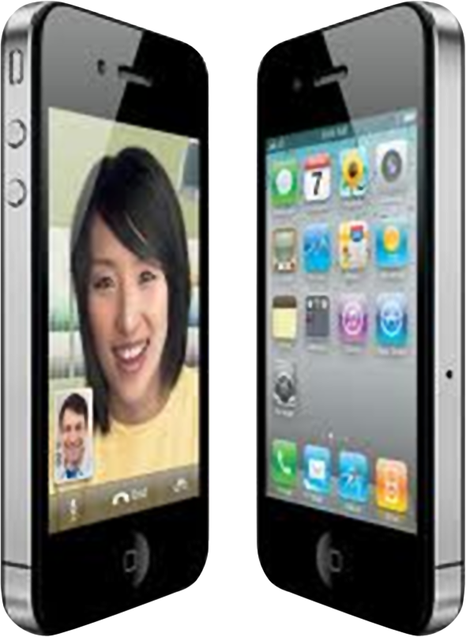
TRITON Mobile Security
Protection from:
  Mobile malware
  Malicious apps
  Phishing & scams
  Advanced malware
  Data theft
Control for:
  BYOD
  Enterprise devices
  Mobile DLP for email
  Web security & apps
  Compliance

Slide 10
















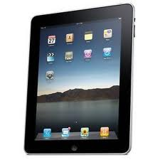



TRITON Mobile Security
Mobile
Email
DLP
Web Security
Mobile Security
Mobile Security
ACE + ThreatSeeker Network
Malicious Mobile App Tracker
Management + Reporting
Exchange
Email Server
ActiveSync*
Enterprise
DLP controls
VPN**
WiFi/3G
Enterprise email
*Any ActiveSync
compatible device
** iOS, Android

Slide 11
Security Intelligence Services
"It's becoming clear that many of these emerging threats cannot be defended against in-house, creating a shift in security posture toward being more proactive.”
IDC Senior Analyst Christine Liebert
IDC press release, Jan. 31, 2012, http://www.idc.com/getdoc.jsp?containerId=prUS23290912
When defenses fail…
You need answers.
How did it get in?
Which defense worked?
Which defense failed?
How is the PC/server/device affected?
Who was targeted?
What data was targeted?
Where is it now?
How do we tighten defenses to prevent a repeat?
Blocking is not enough. IT needs resources to become proactive.

Slide 12
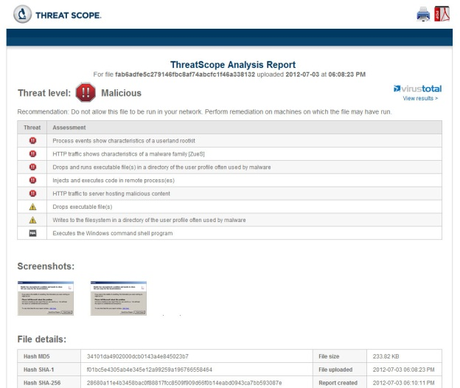
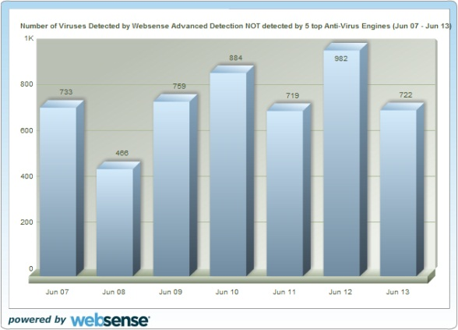

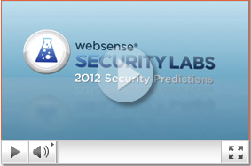

CSI: On-Demand
ThreatScope malware analysis sandbox
Priority access to a variety
of research tools/services
On-demand videos
  Security Labs TAB events
  Research presentations
Threat & Security training including:
  Analyzing mobile malware
  How to de-obfuscate JavaScript
  Dynamic analysis of malicious files

Slide 13
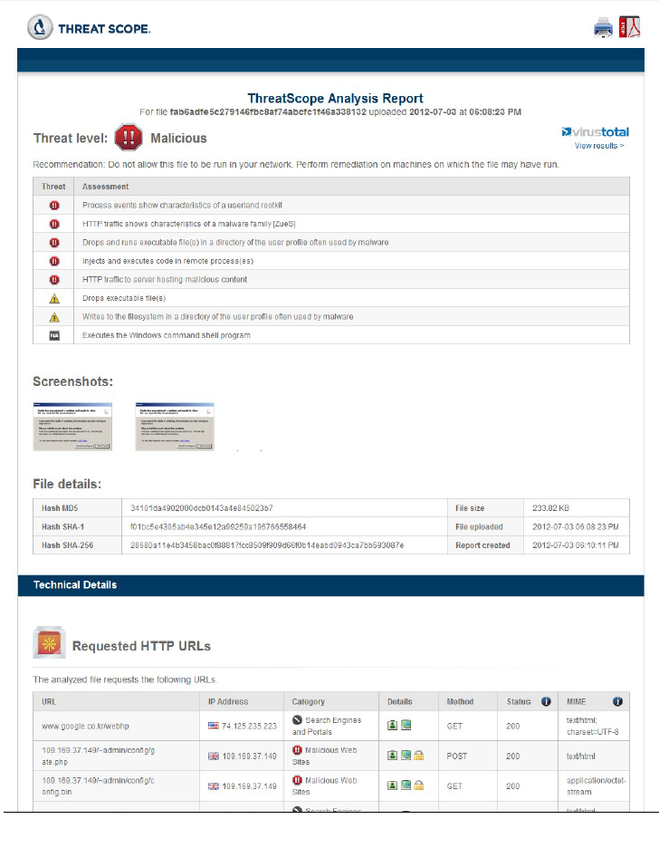
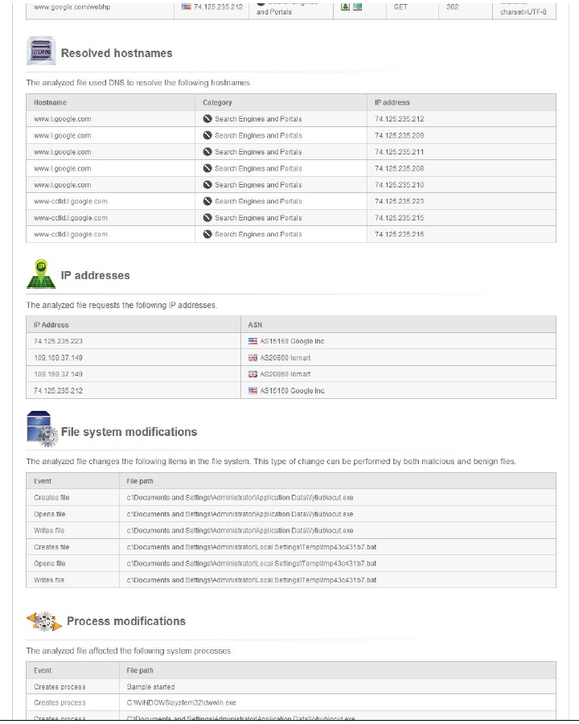
Websense ThreatScope™ Sample Report
Notes:
Next-> further sample

Slide 14
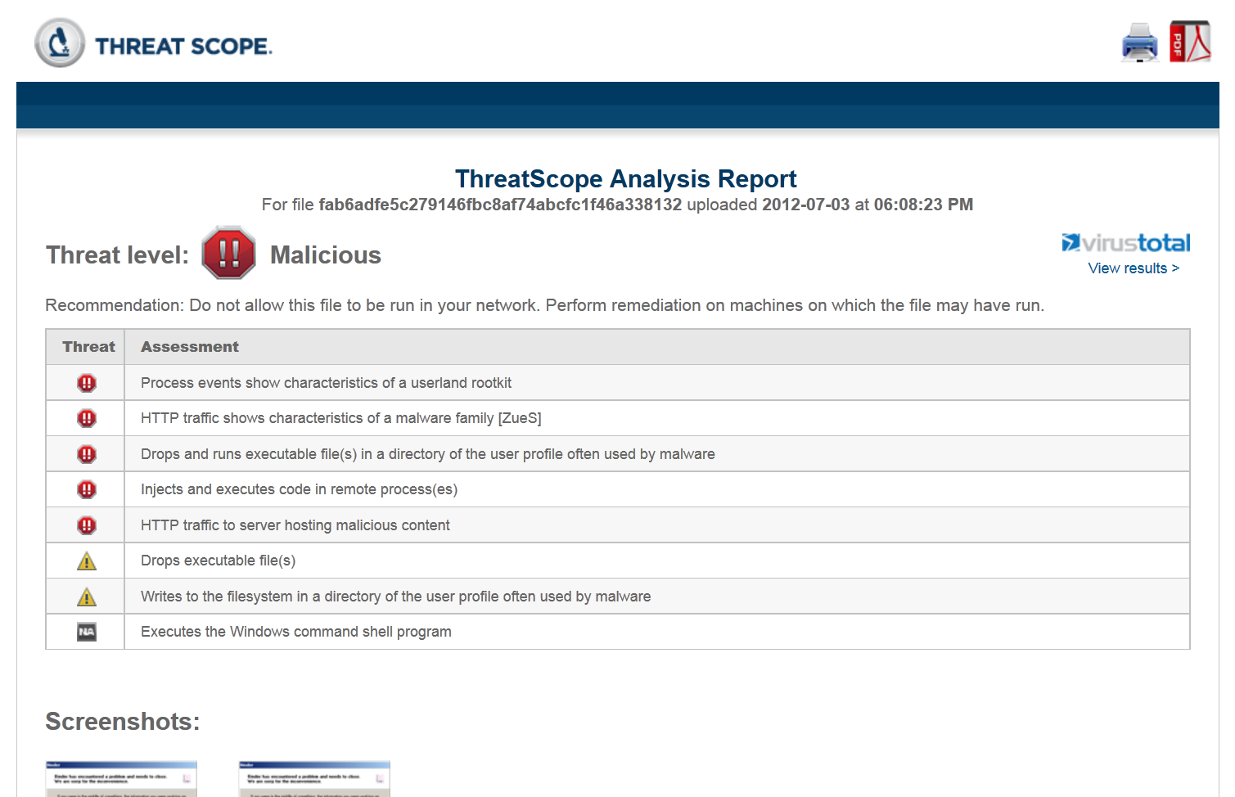
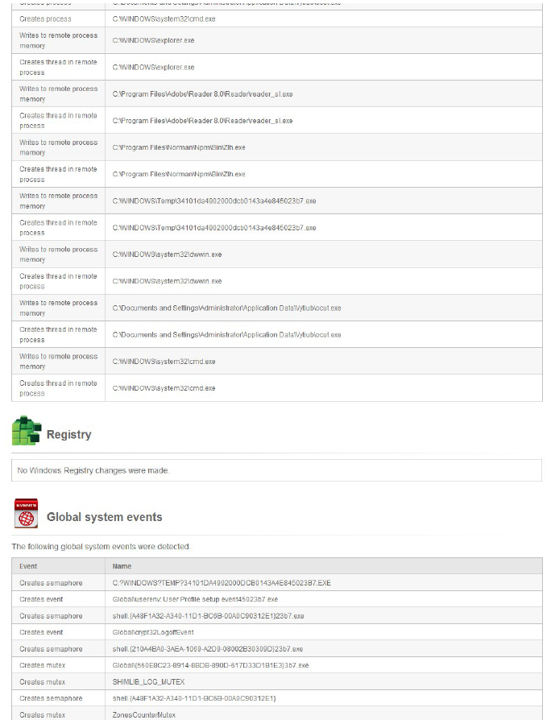
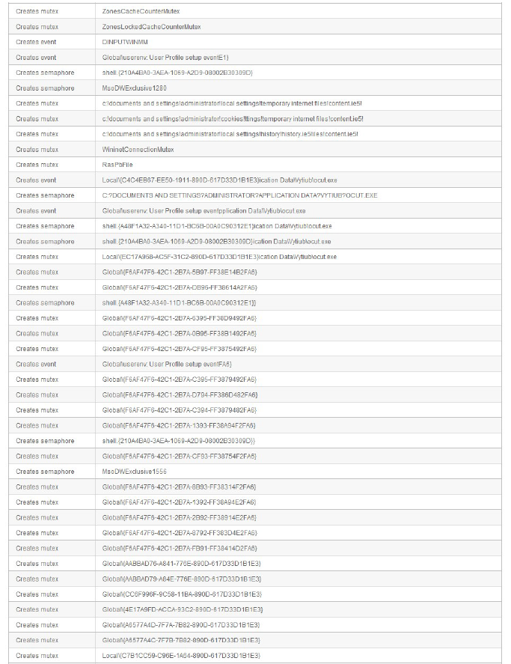
Websense ThreatScope™ Sample Report…cont

Slide 15
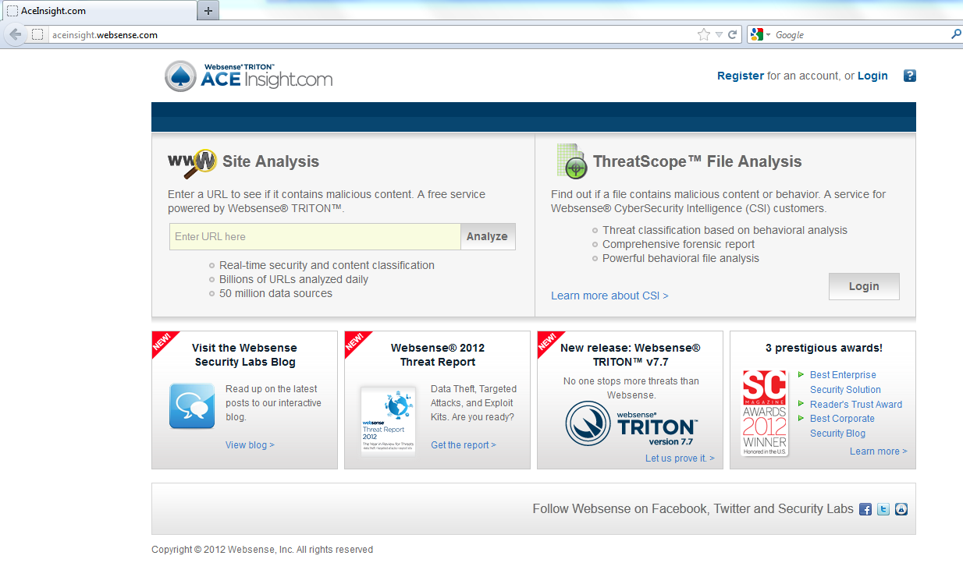
aceinsight.com

Slide 16
Thank You!
Resources
Websense Security Labs
  http://securitylabs.websense.com/
CyberSecurity Intelligence services
  http://www.websense.com/content/cybersecurity-intelligence-services-overview.aspx
Triton Mobile Security
  http://www.websense.com/content/TRITON-mobile-security-overview.aspx
Websense Turkey Facebook Group
  https://www.facebook.com/groups/WebsenseTR/
Questions ?
Abdurrahman Beyazaslan
abeyazaslan@websense.com

