Slide 1
Advanced Threats & Data Theft
New TRITON v7.7 Defenses
Joseph Gow
Director Product Management, DLP

Slide 2

New Defense Game

Slide 3





4 Reasons Why Current Defenses Fail
1
PRIMARILY BASED ON
SIGNATURE & REPUTATION
2
LACK OF REAL-TIME
INLINE CONTENT ANALYSIS
History is not a reliable indicator of future behavior.
Signature creation cannot keep up with the dynamic creation of threats
Collect samples for lab analysis using background processes
Producing new signatures (network/file) and reputations (URL/file)
3
FORWARD FACING ONLY,
LACK OUTBOUND PROTECTION
4
MORE OF THE SAME IN
NEW DEPLOYMENT OPTIONS
Not data-aware, lack contextual analysis, minimal to no forensic visibility
UTMs, NGFWs, IDSs, Network Threat Monitors
SSL severely impacts performance,
or blind to it

Slide 4







Seven Advanced Threat Stages
Recon
Lure
Redirect
Exploit
Kit
Dropper
File
Call
Home
Data
Theft

Slide 5
Seven Advanced Threat Stages
AWARENESS
Web & Email
Facebook, Blogs, Tweets
Spear-phishing
Trusted entry
Targeted
Dynamic
Timed
Recon
Lure

Slide 6
Seven Advanced Threat Stages
REAL-TIME ANALYSIS
Browser code & active scripts
Link analysis
Exploit analysis
Composite scoring/ratings
Predictive
Redirect
Exploit
Kit

Slide 7
Seven Advanced Threat Stages
INLINE DEFENSES
App analysis
Malicious PDFs
Multiple AVs
File compress.
Dynamic DNS
Botnet & CnC comms
Dropper
File
Call
Home

Slide 8
Seven Advanced Threat Stages
CONTAINMENT
Data theft defenses
Embedded DLP
Data capture
Geo-location
Forensic details & reporting
Alerts/severity
Data
Theft

Slide 9
Advanced Threat Techniques
Evading Detection

Slide 10







Criminal Encrypted Uploads
Proprietary encryption
Cloak comms & data theft
Crimeware toolkit enabled
Blind spot for defenses
Web

Slide 11


Password File Data Theft
Password files
Active Directory/SAM database
Expand reach/control within target
First priority once inside
Web

Slide 12



Non-Document Data Theft
Image files
Confidential information
Smart phone pictures
Blind spot for defenses
Web

Slide 13



Slow Data Leaks
Remain below the radar
Low record count per request/incident
Steal data in small chunks
Persistence and patience
One data
record
One data
record
Web

Slide 14




Email Security Evasion
Spear-phishing technique
Embedded web link in email lure
Time malware infection after delivery
Email security sees a clean link
Sunday
Monday
Target
Web Site
Target Site
Infected 4am
Email
Security
OK
Web
Web

Slide 15
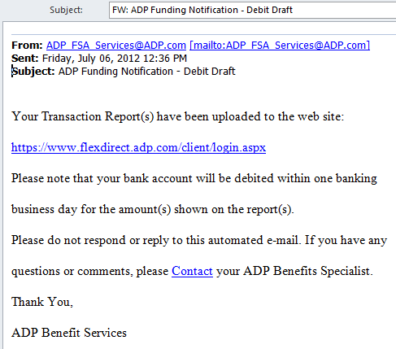
Recent Example – 6 July 2012
Financial notification
Appears as payroll related
Debit to bank account
Online transaction report

Slide 16
Customer Requirements
Solving Open Issues

Slide 17

New Security Requirements
Protection from advanced threats
Containment against data theft
Threat dashboard with severity alerting
Forensic reporting with SIEM integration
Malware analysis sandboxing & services
Performance & availability of defenses

Slide 18

Security Platform
Unified architecture
Unified security intelligence
Unified console
Unified policy & reporting

Slide 19
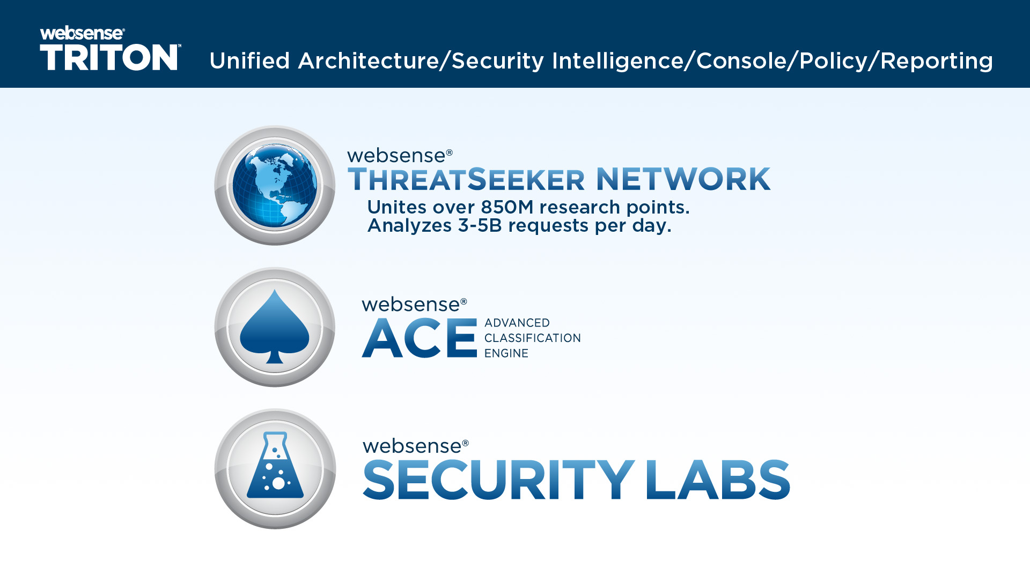

Slide 20


Identifying Information Loss Risks
CONTEXT
+
Content Classifiers
WHAT
WHO
WHERE
Websense DLP > real-time data awareness
Websense User Service
> real-time user I.D.
Data Theft
Machine Learning
Websense Web Intelligence > real-time destination awareness
Fingerprinting
Natural Language Processing
Keywords / RegEx / Dictionaries

Slide 21
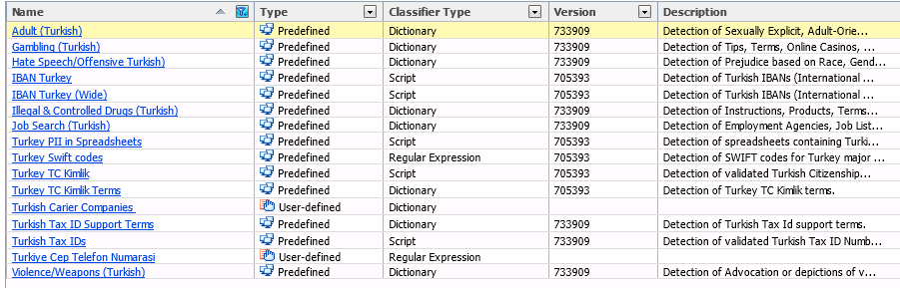
Described Data

Slide 22
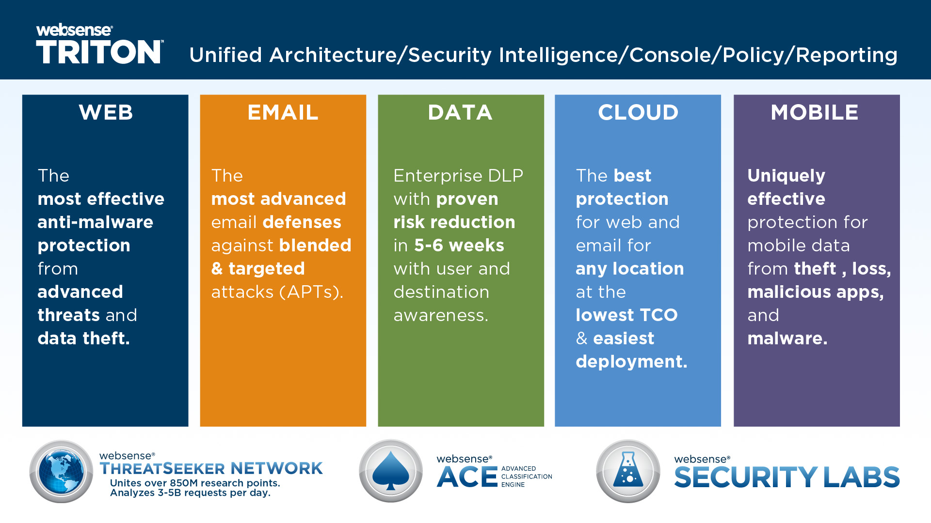

Slide 23
Key New Features
Advancing the TRITON Architecture

Slide 24

Seven Industry Firsts
Web URL & File Sandbox Service (CSI)
Criminal Encryption Detection
Forensic Data Capture
Password File Data Theft
Email URL Sandboxing
OCR for Data-in-Motion
Drip (Behavioral) DLP
TRITON 7.7

Slide 25
Defense Effectiveness
Real-Time Analysis
Too Slow
RT Security Classifiers
RT Content Classifiers
RT Data Classifiers
Anti-Malware Engines
URL Classification
Reputation Analysis
Anti-Spam/Spear-Phishing
Predictive
ACE
Cloud-Assist
Known
Threats
Unknown
Threats
AV+URL+Rep
Sandbox
AV
NGFW
Reactive
Too Late
Background Analysis

Slide 26
Zero Day Browser Exploits – Q1 2012
98.1%
Websense
Security SaaS-1
79.2%
71.94%
Large AV Vendor
63.5%
1st Gen. Proxy Gateway
47.0%
URLs containing malware, Q1 2012
NGFW Vendor
31.3%
Security SaaS-2
1.9%
UTM Vendor

Slide 27
Botnet Outbound Comms – Q1 2012
97.0%
Websense
44.0%
Large AV Vendor
26.0%
1st Gen. Proxy Gateway
24.6%
Security SaaS-1
URLs containing malware, Q1 2012
Security SaaS-2
24.5%
12.0%
NGFW Vendor
0.0%
UTM Vendor
Notes:
Websense consistently outperforms the competition in blocking outbound bot communications from infected clients to command and control servers on the internet.

Slide 28
Thank You.
Thank You.

