Slide 1
APT or Targeted Attack, What’s the Difference?
Michael Cryer,
Consulting Systems Engineer

Slide 2
Bio
Michael Cryer, CISSP
Consulting System Engineer
4 Years at Websense
  General Sales Engineering & Research
    Member of Satellite Research Team (Websense Security Labs)
    Advanced training and sales methodologies for technical Sales Engineers
5 Years at PricewaterhouseCoopers
  Lead Northeast practice for forensic investigations
    Certified Forensic Investigator: TJX, BJ’s Wholesale, and several fortune 100 companies
    Analyzed data breaches & provided recommendations for remediating risk
  Member of Attack and Penetration Core Team
    Developed attack strategies and assessment methodologies

Slide 3
What is an APT or Targeted Attack, and why should I care?

Slide 4
Advanced Persistent Threats
Advanced Persistent Threat, n.
“A group, such as a foreign nation state government, with both the capability and the intent to persistently and effectively target a specific entity.” (Wikipedia)
Advanced Persistent Threat, n.
“Really nasty malware.” (Everybody Else)

Slide 5
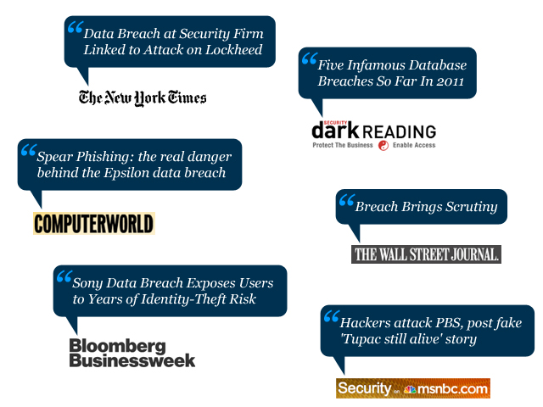
APTs are all over the news

Slide 6
Major attacks last 18 months
January 2010 – Aurora hits Google, Adobe and 30+ large organizations. Used 0-day in IE.
March 2010 – NATO announces that they’ve seen a significant increase in cyberattacks against their network in the last 12 months
April 2010 - Attackers gain access to systems within the Indian Defense Ministry and Indian embassies around the world.

Slide 7
Major attacks last 18 months
September 2010 – Stuxnet, a highly advanced and targeted malware, was found. This was the first malware to specifically target critical infrastructure, in this case a nuclear facility in Iran.
February 2011 – Night Dragon is announced. Targeted attacks against oil, energy and petrochemical companies
March 2011 – RSA reports they have been a target of an APT using a 0-day in Adobe Flash coming via attached XLS file.
  Stolen RSA Token algorithm was later used on specific targeted attacks vs. US Defense contractors

Slide 8
The big picture
APT is just a buzzword
  These types of attacks have been around for over 5 years
  The majority of these targeted attacks use re-packed versions of existing, well-known Remote Access Trojans (RAT’s)
  They happen almost daily.
  Security vendors and the media are creating cool names for groups of attacks (it gets a lot of attention).
Whether an attack is an APT or not, this is simply a matter of semantics, and REALLY doesn’t matter if you are the one under attack.

Slide 9
APT or targeted attack?
Are all attacks APTs?
  Some are, but most are not
  The business impact is real either way
  The attacks need blended defenses, one single technology won’t stop it
Targeted attacks
  Majority of attacks don’t use a 0-day vulnerability
  The attacker very often uses a repacked version of a well-known Remote Access Tool
    Poison Ivy, Gh0stRAT, zwShell
  Even if re-packed the communication protocol stays the same (HTTP/s)
  Often connect to Dynamic DNS hosts
Advanced Persistent Threats Example: Aurora | Characteristics | Targeted threats Example: Epsilon
Leveraged an unknown Internet Explorer vulnerability using malware binaries and a backdoor connection that masqueraded as an SSL connection to command and control victims’ servers | Sophistication Uses the full spectrum of attack methods, including email phishing, website malware, Trojan downloads, and more | Used social engineering to send emails that enticed employees to open an Excel file that contained a Flash vulnerability
Targeted Google and dozens of other major corporations, including Adobe Systems, Yahoo, Morgan Stanley, and Dow Chemical | Specificity Targets a particular entity and has a specific mission to accomplish, typically of a military, political, technical, or economic nature | Targeted a major email marketing company whose customers included Visa, Kraft, and Marriott International
Custom-built to exploit an unknown vulnerability in Internet Explorer, thus evading traditional security measures with a “zero-day” attack | Specially designed Custom-built for specific purposes; often a first-of-its-kind exploit that’s never before been seen or detected
Masterminded by the Chinese government to locate, steal, and modify source code repositories at high-tech, security, and defense contractor companies | Sponsorship Backed by governments, organized crime, or other entities with deep-pocket funding; managed by well-organized “crews” with highly coordinated assignments to accomplish

Slide 10
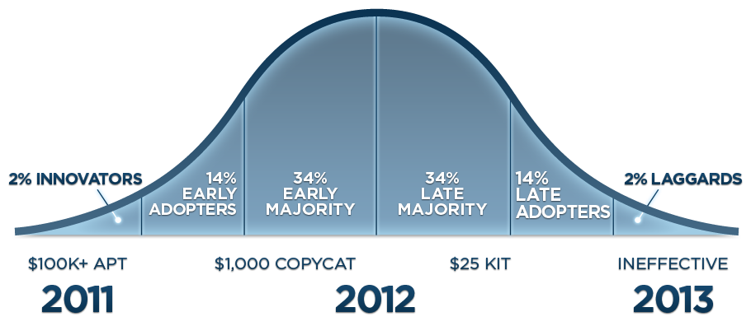
Malware Adoption Lifecycle

Slide 11
Where is the data sent?
China in many cases, sometimes North Korea
C&C/data drop use Dynamic DNS hosts
  liciayee.dyndns-free.com (CVE-2011-0611, Adobe 0-day)
  obama.servehttp.com, prc.dynamiclink.ddns.us (RSA attack)
  is-a-chef.com, thruhere.net, office-on-the.net, selfip.com (Night Dragon)
Websense is adding a Dynamic DNS category which can be used to block access to websites and block data from being posted.

Slide 12
How do they work?

Slide 13
3 Phased Approach
Attack Phase 1
PLAN, LAUNCH, INFECT / SUCCESS
The initial phase is when the attacker performs some sort of reconnaissance, launches and attack, and then infects hosts within the target environment.
Attack Phase 2
CONTROL, DISCOVER, PERSIST
The second phase is post infection. The attacker now will be controlling the infected hosts, updating the code, and discovering other machines and data on the network.
Attack Phase 3
UPLOAD, UPDATE, TAKE ACTION
The final phase is when the attackers have captured data and are uploading it and then taking action on the data.

Slide 14
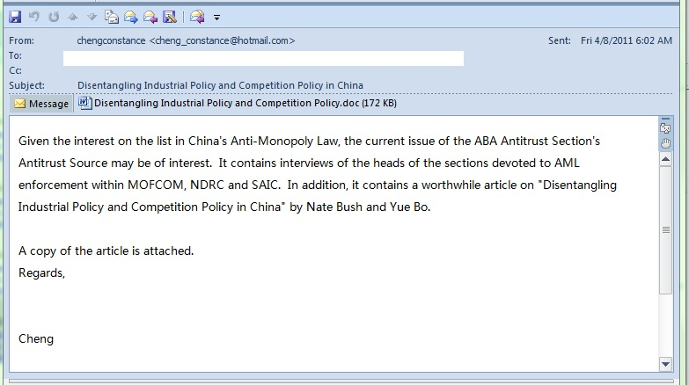
Phase 1 - PLAN, LAUNCH, INFECT / SUCCESS
Reconnaissance & launch of Attack
  Email campaigns, IM Links, Malicious Web sites
  Social Networks
  USB Flash drives
Exploits:
  APT’s use 0-days
    Adobe, Microsoft, Browser Exploits
  Targeted Attacks use repackaged known exploits that typically haven’t been patched.
    SQL Injection
    MS, Adobe Flash, etc.

Slide 15
Phase 2 - CONTROL, DISCOVER, PERSIST
Command and Control
  Remotely update sync, modify, and send other commands to the host
  Typically repackaged toolkits: Poison Ivy, Night Dragon, and zwShell
    Used to download additional tools for further exploitation
Traditional malware often will not persist on a machine, may be cleaned, remove itself or be detected and removed by an anti-virus program. Modern malware is designed to be stealthy and go unnoticed; additionally it is designed to persist back to the command and control center for updates to new undetected code to avoid detection by updated antivirus solutions.
CONTROL
DISCOVER
PERSIST

Slide 16
Phase 3 - UPLOAD, UPDATE, TAKE ACTION
The last phase is the ultimate goal for the attacker; this is when they steal data from the target.
  APT attacks are looking for specific data
    RSA – Looking specifically for Secure ID token Algorithm
      Typically get in and out with out being detected
  Targeted attacks typically create havoc (Anonymous)
    Web site defacement
    Can persist for several months/years (TJX, Sony)
    The attack becomes public knowledge and the media publishes information about the fact
    The attacker decides to extort the victim
    Information about the attack is shared amongst attackers and if the attack wasn’t thwarted by the victim, additional attacks from other groups take place

Slide 17
Packaged Tools: Poison Ivy

Slide 18
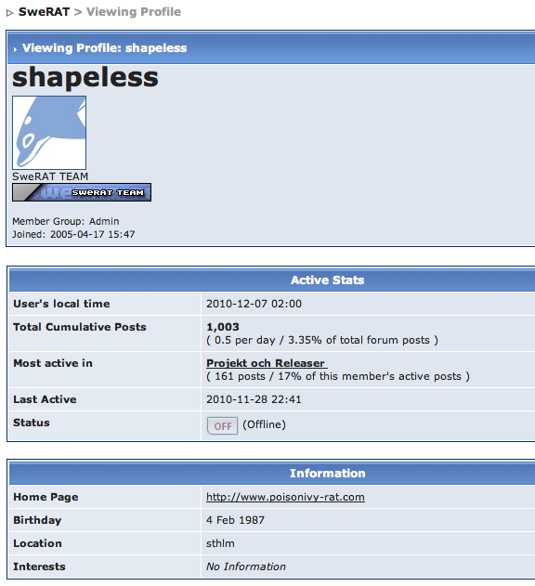
Poison Ivy
Available at
http://www.poisonivy-rat.com
Created by a Swede called
“shapeless”.
His real name is Jonas

Slide 19
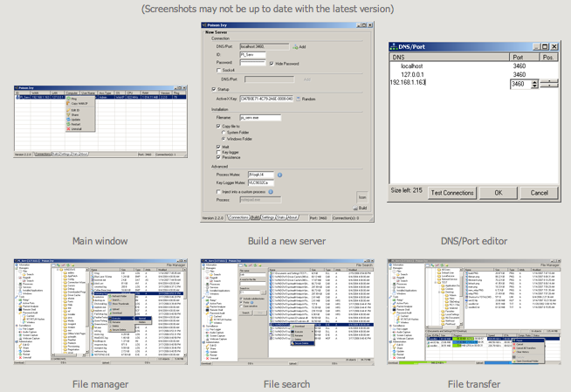
Poison Ivy
Reverse-connection
Keylogger
Upload/Run files
Remote Shell
View/Edit Registry
Screen/Audio capture
Much more…

Slide 20
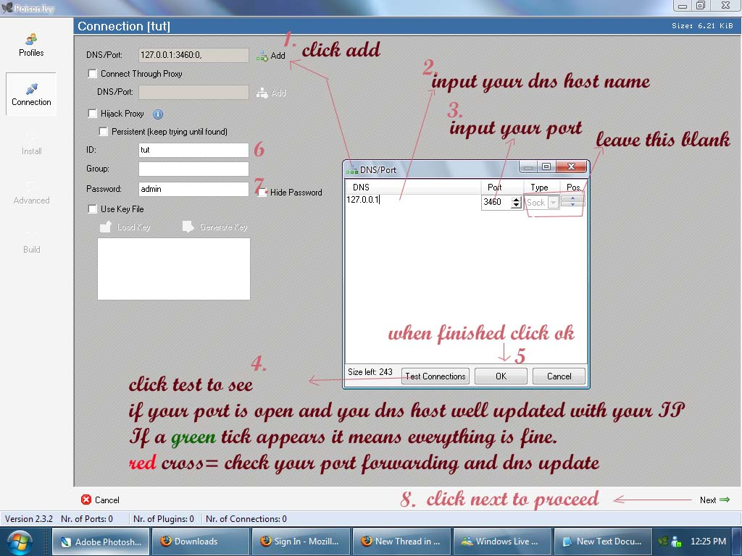
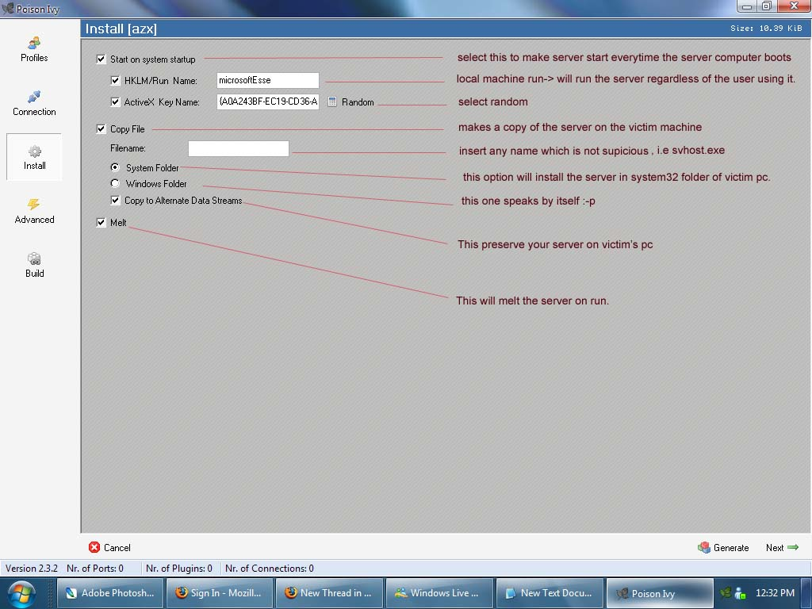
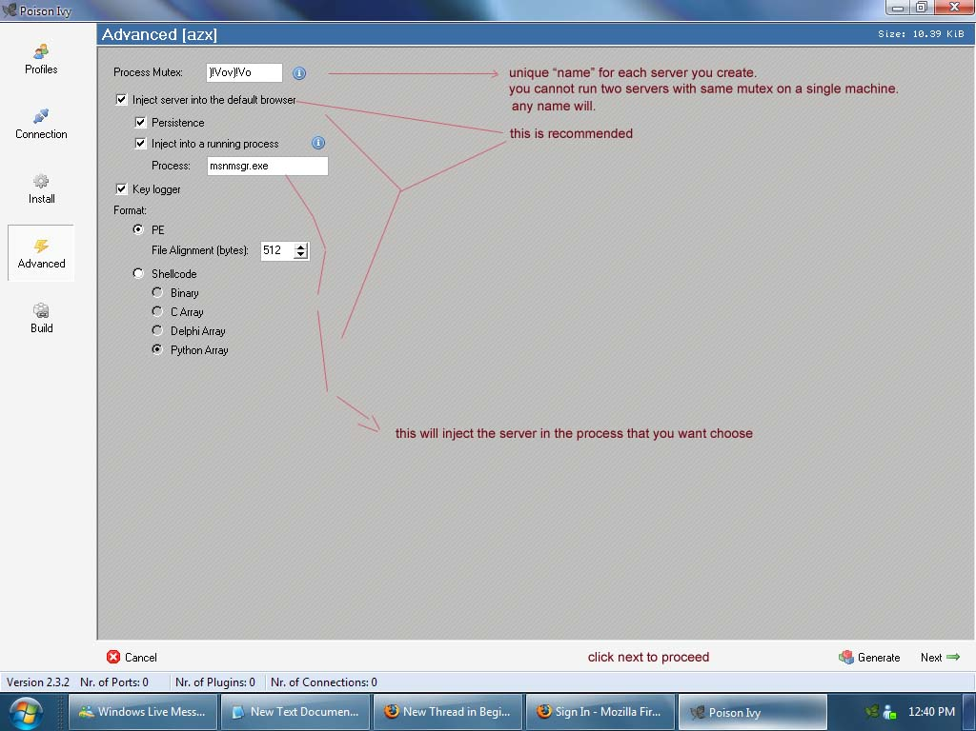
Poison Ivy Builder
Notes:
The Poison Ivy builder application let’s the attacker specify all options of the client such as URL and port of the server, username/password to control the client, where on the system it should install and where in the registry it should add its entries and if the application should inject itself into an already running process to trick application control technologies. You can also create the client as shellcode and include it in an exploit and embed it into a PDF file for to automatically install it.

Slide 21
How do you stop these attacks?
Preventing infiltration & Preventing data exfiltration (containment) by
combining known techniques to stop blended attacks

Slide 22
Solutions must be context-aware
The technology needs to be context/content aware
  Inbound traffic
  Outbound traffic
  Reputation
  Data/Content classification
  Anomalies
  Protocol inspection

Slide 23
















The ThreatSeeker Network
Websense
Web Security Gateway
Threat Detection/Probes
1 billion pieces of content per day
Real-Time Security Updates
Shared Analytics/Feedback
Websense
Hosted Customers
2+ million
posts per day
Websense
Security Labs™
10+ million emails per hour
Websense
Hosted Security
URL and Security Database
200+ million
sites per day
Notes:
At the heart of our innovative approach is the 100-strong dedicated team of security researchers that forms the Websense Security Labs.
The Security Labs use Websense ThreatSeeker technology to discover, investigate and report on advanced Internet threats that traditional security research methods would miss... And the global team ensures that this takes place 24 hours a day.
Our Essential Information Protection vision depends upon the ThreatSeeker™ Network. This is an advanced infrastructure for early threat discovery across email and Web channels, real-time identification and blocking of high-risk Web sites, and data identification techniques and technologies. Websense Web, messaging, and data security solutions use security intelligence from the ThreatSeeker Network to provide the most up-to-date protection from data loss, unwanted content, and malicious threats.
ThreatSeeker combines heuristics, binary analysis, reputation, image analysis, lexical analysis, pattern detection, statistical analysis, natural language processing, data fingerprinting, and actual research experts across disciplines. These tightly coupled techniques and capabilities identify and classify data and content within the enterprise and across the Internet to drive understanding of new threats as they develop. The statistics from this network are phenomenal with 1 billion pieces of content analyzed every day.
We have established capabilities across all of our business communication channels. We’ve integrated our threat environment so now our ThreatSeeker network that has a ton of intelligence about the Web and we integrated, in real time, that with our SaaS email security offering. Meaning that email know has a much greater awareness and understanding of web threats. Similarly we harvested what our email security systems were seeing to give us more information about phishing and pharming and spam attacks so that we could make our web threat analysis even stronger, feeding all that intelligence back into the products that our customers run today.
We integrated that domain intelligence so now we have a unified threat system that’s helping each one of these product areas. The email systems a lot smarter because now when it sees or that html email traffic in it, it knows a lot about those web links and the web systems are more knowledgeable because they are getting all that feed of email spams that are coming in, understanding the campaigns that the cyber criminals are launching where they are trying to lure people to the web and we’re cutting that off just there. Our data engines that we use underneath this have a much deeper knowledge of the content that is traversing the networks.

Slide 24
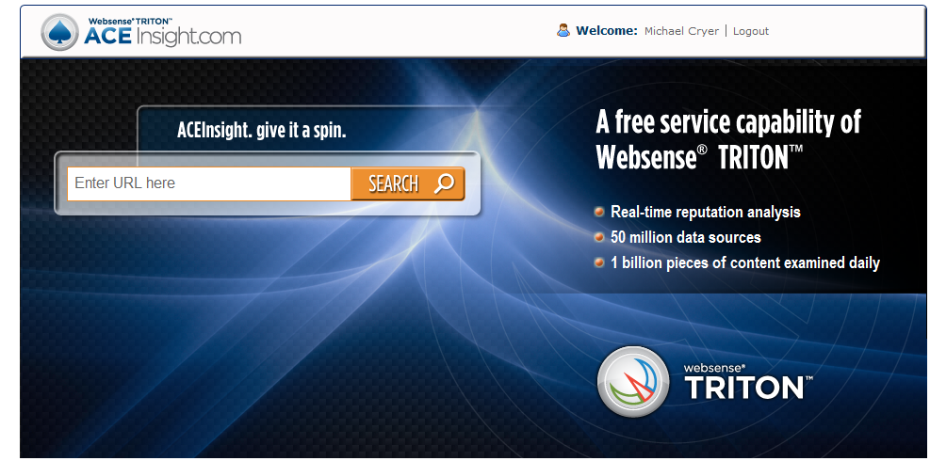
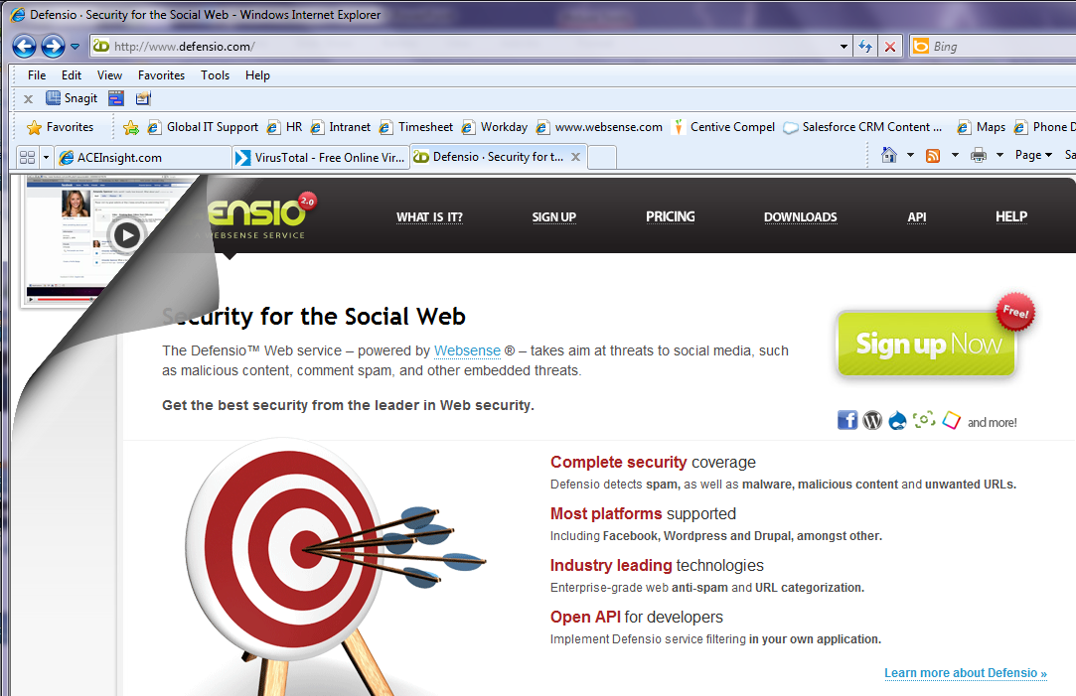
Free ThreatSeeker

Slide 25
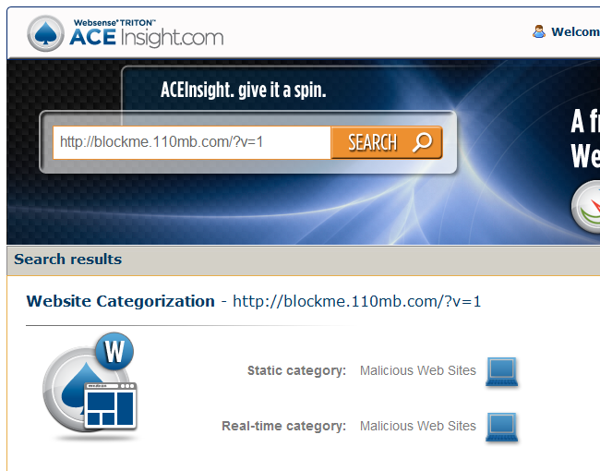
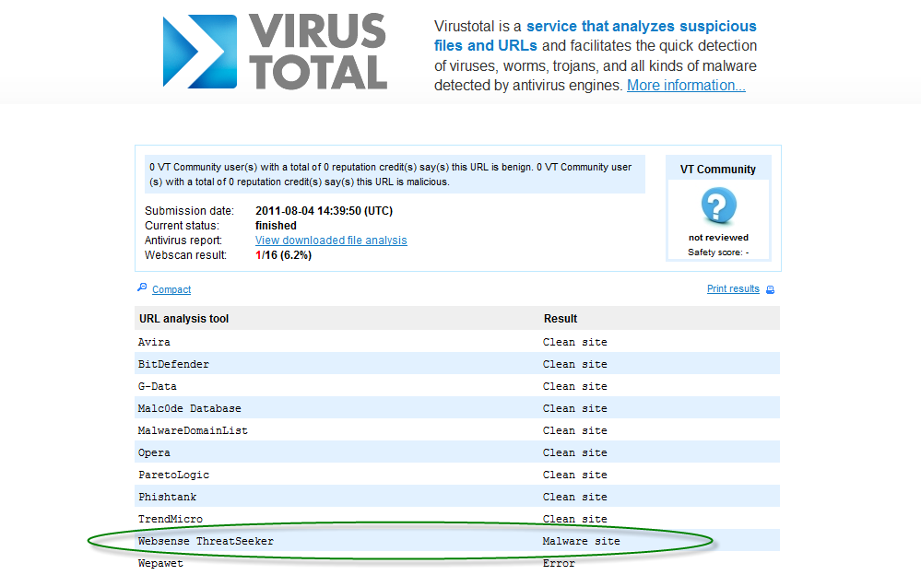
ThreatSeeker Analytics

Slide 26
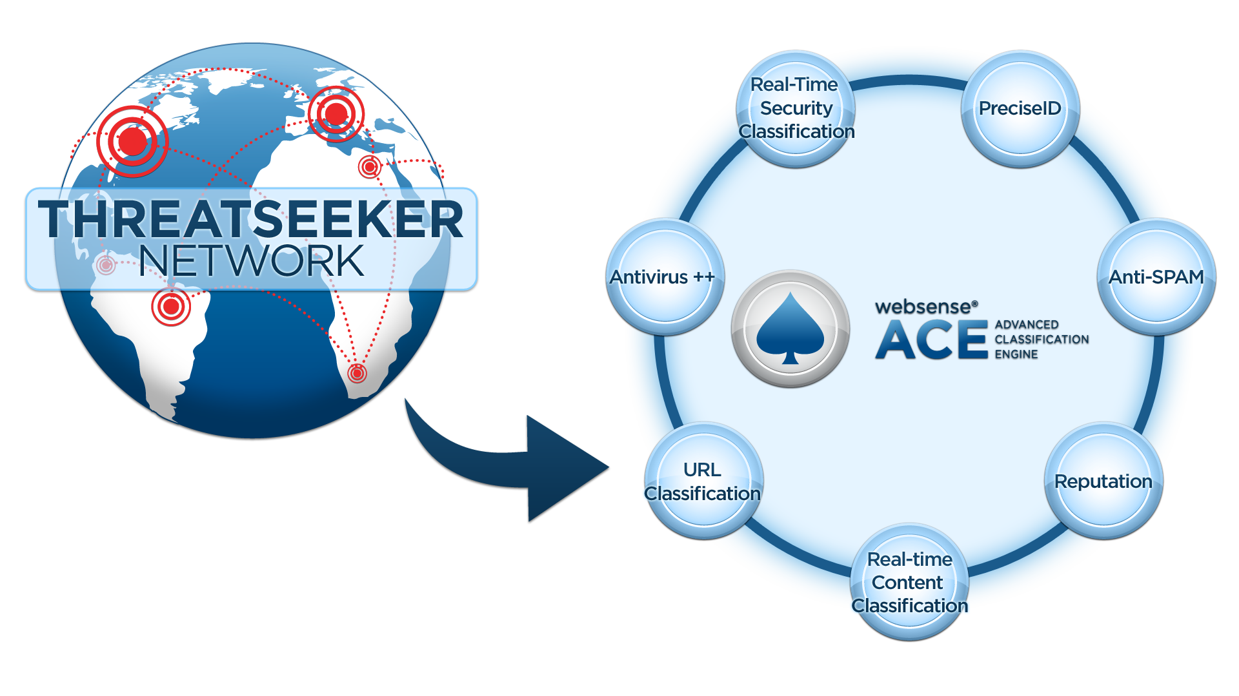
Technology strategy

Slide 27
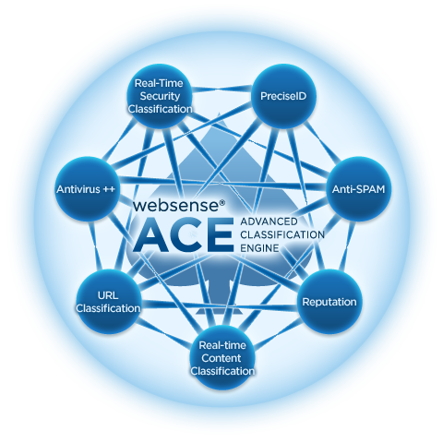
Technology strategy
ACE allows us to protect customers where others do not
Outbound content scanning is critical
One analytic can trigger on its own or multiple engines can participate in voting algorithm
Each analytic broken down in following slides

Slide 28
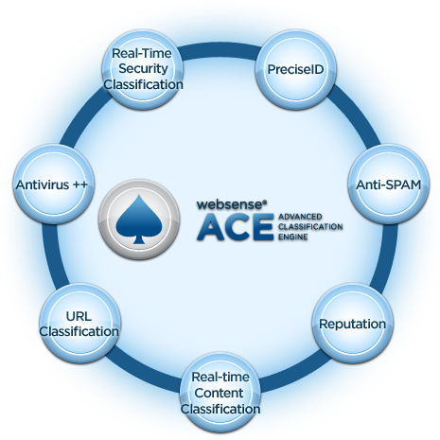


Technology strategy
Real-time inspection and
analysis of web content for the purpose of identifying exploit- and malicious code
Built in parsing, obfuscation detection, de-obfuscation
Specific attack ThreatID’s, generic attack profiles, signatures, rules, attributes, kit detection, and anomalies
Responsible for discovery of large zero-day attacks, including Aurora. Publicly cited by Microsoft on five of them

Slide 29
Technology strategy
Designed for known and
unknown binary threats (executables)
AV signatures for legacy and known attacks
Integrated heuristics and signatures for unknown attacks
Generic profiles and ThreatID’s for kit created files and packers
Inspection and advanced classification of exploitable file-types (PDF, SWF, Office files)

Slide 30
Technology strategy
Designed as
categorization filter, performance, and component of score
95+ categories (10 for security alone)
40+ updates per day
Directly connects to cloud for additional lookups and attributes

Slide 31
Technology strategy
Real-time content classifiers
Machine learning classification (SVM+)
Rules-based algorithms on URL and content
Multi-lingual
Special classifiers for large properties like Facebook
Can be configured with weights and thresholds in the backend for accuracy vs. coverage and by customers

Slide 32
Technology strategy
Designed for web and email,
inbound and outbound
20+ points of reputation scoring (property, neighborhood, lexical, ASN, age, volume, anomalies, DNS, registration details, geography, etc)
Real-time push of reputation updates
Connects to cloud for additional feeds
Scores generated in real-time and in backend

Slide 33
Technology strategy
Sender scoring and reputation
Email message content scanning and scoring
Heuristics
Correlation over customer mails, scoring, volume, and type
URL analysis and complete connections into other analytics

Slide 34
Technology strategy
Designed for structured and unstructured data classification
More than 800 shipping pattern policies
More than 400 file-types support with parsing and decoding

Slide 35
Technology strategy - voting
Voting or correlation is becoming
more and more important with detecting complex and unknown threats.
Simple example is real-time is unknown obfuscation type, site reputation is below score threshold, and URL DB is un-categorized = potential malicious site or sample.
Complex example is URL is categorized as dynamic, reputation is questionable, content-type outbound is encrypted but not by SSL or a known encryption algorithm = potential APT / threat.

Slide 36
Prevention of Attacks – Email with Attachments
The most prominent attack vector to gain access into organization is to blend threats together. Most usually start with an email to a target individual. The email either includes an attachment with an unknown exploit or a link to a website with a browser or file-based exploit. In most cases this email has context that is organization specific in order to provide authenticity and frequently is from another employee at the organization or is spoofed as one.
Our Advanced Classification Engine will examine the email sending location, user, and content particulars to determine if there is suspect data there that matches. It is uncommon for modern malware to match any these characteristics in brand-new attacks, however we have seen common heuristics that may allow us to prevent here.
Next we will do a deep analysis on the actual file that has been attached. This includes scanning through several Anti-Virus engines first. Again, it is rare that AV engines will have a signature match for an unknown file. At this point we have our own exploit analyses engine that will look into the file to determine if it has code, exploit attributes, or other anomalies. We often can catch code here that is suspect. One example is that it may be a PDF with embedded SWF actions or a Word DOC with a PDF with action script ,etc..

Slide 37
Prevention of Attack – Email with Links
Emails containing links to websites
Often the content of the email is simply not sufficient to provide accurate classification in modern malware attacks. At this point our Advanced Classification Engine will examine the web URL to determine if it matches a security category and calculates the reputation of the destination site. At this point our engine will run through it’s advanced exploit classifiers looking for known exploits, heuristics, and suspect content.
In many cases of modern malware attacks not one of our classifiers has enough evidence to trigger an accurate classification. In this case we combine the net of all classifiers to determine a composite score. We call this concept voting. All engines participate in the scoring algorithm and different weights and thresholds are applied. This is the number one way we prevent modern malware attacks in phase 1 today.
Dynamic DNS links contained in emails are very prevalent
for these types of attacks.

Slide 38
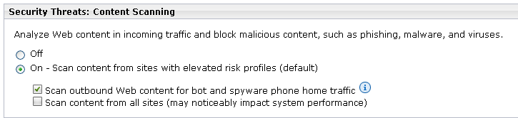
Prevention of Attacks – Email with Links
Severing Command and Control
Assuming that the attacker has successfully infected a host within the organizations network our defense then relies on the severing of the connections back to the command and control host. The most common ways that we have seen modern malware connect back is through the HTTP/HTTPs protocols, tunneling over port 80/443, or through a custom protocol. We recommend that customers do not allow custom protocol traffic to leave their networks. Because most do already we usually see the traffic going over open ports like 80 and 443.
Triton Manager Outbound Scanning for Bot Traffic

Slide 39
Stopping the Attack
Outbound Command and Control Classification
The Triton Architecture allows you to enable outbound inspection for the means of classifying and preventing command control connections post infection. When enabled all outbound traffic is inspect with the Advanced Classification Engine and assigned to policy.
For Command and Control we will examine the destination, their reputation, the content, and the payload (if data), of the requests. Triton includes security categories that will match for outbound and sever the connection to the command and control host. The most common is the “bot network” category.
Websense will release this month, the ability to block or control access to dynamic DNS sites for both web traffic and data loss prevention.
Outbound Protocol Inspection
Within the Web Security Gateway there is also the ability to inspect, examine, and classify content that traverses port 80 and 443. There are many cases when the command and control connection simply tunnel over port 80/443 but are not actually HTTP traffic. Here we have the ability not just to decrypt the traffic if it’s really HTTPS, but also to inspect the traffic for legitimacy, anomalies, and possible certificate exploitation.

Slide 40
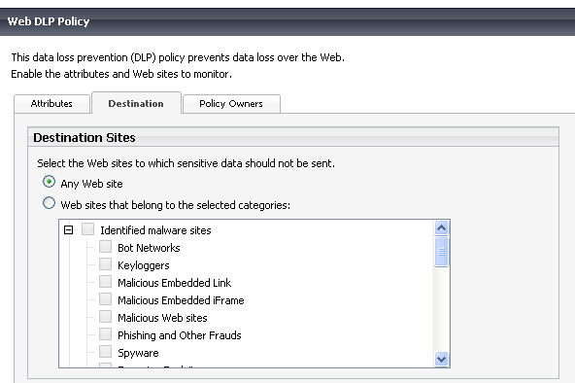
Protecting the Data
Outbound Data Inspection
Triton allows administrators to identify content that is unique to their environment that has intellectual property and other sensitive data in it. This can be done for a variety of supported document types, databases, and file formats. Our classification system is very accurate and contains representations of your data. With this we can identify data that has been modified without having to re-analyze it.

Slide 41
Questions?
Thank You…

