Slide 1
Now You Can Defend Against the High Risks of Shadow IT
Frank Cabri, Vice President, Marketing, Imperva Skyfence
Jim Fulton, Senior Director, Product Marketing, Raytheon|Websense
August 12, 2015

Slide 2
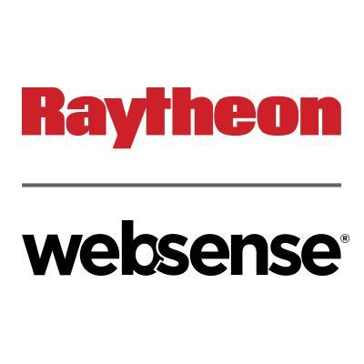
Today’s Presenters
Frank Cabri
VP Marketing, Imperva Skyfence
Imperva
frank.cabri@imperva.com
Jim Fulton
Senior Director, Product Marketing
Raytheon|Websense
jfulton@websense.com

Slide 3
Agenda
About our Relationship
Understanding the Shadow IT Problem
Challenges of Shadow IT
The Websense Approach
Q&A
Notes:
Here’s a lil sneak peek at what we’ll be covering over the next hour or so.
We’ll start with a very brief overview of the market Skyfence plays in, taking a closer look at the risks and gaps vendors are trying to address. We’ll spend some time examining the popular use cases of Skyfence, which will set the stage for a discussion on the new v4.0 features.
Next, we’ll go over some of the main deployment considerations as customers look to implement Skyfence within their environments.
Then we’ll hit the juicy part of the presentation – a live demo. This’ll give you chance to see for your own eyes Skyfence in action.
And, finally, we’ve set aside some time towards the end to answer any questions you might have.

Slide 4
About Imperva Skyfence
What does Imperva Skyfence do?
Enable organizations safe and productive use of corporate SaaS applications
Why is it relevant?
The cloud app trend has created a visibility and control blind spot for IT that cannot be addressed by traditional security
Imperva – Protecting data and apps
Only leader in Gartner Magic Quadrant for Web Application Firewalls for two consecutive years
Top ranked in Forrester Wave Report for DDoS Service Providers, Q3 2015
800+ employees
4000+ Customers in 75+ countries
Notes:
Let’s start with the easy stuff – who is Skyfence? In a nutshell, Skyfence provides visibility and control over the use of cloud apps. This includes the automatic discovery of cloud app use, contextual risk assessment, and enforcement of appropriate controls for SaaS and production apps in order to mitigate risk.
Skyfence was founded in response to the rapidly growing trend of cloud app usage in the workplace, specifically the visibility and control blindspot for IT because many of these cloud apps are being used without IT’s blessing or knowledge. And traditional controls can’t address these new pain points caused by the cloud. Hence, Skyfence saw an opportunity to address these pains.
Skyfence was the first company to be acquired in this space, having been acquired by Imperva a year ago for $60 million. And, since all of you are already familiar with Imperva and its domination in the Web Application Firewall space, I won’t regurgitate the stats you see at the bottom of your screen.

Slide 5
About Raytheon|Websense
A New Era of Defense-Grade Cybersecurity
Notes:
R|W is a combination of two leading security companies, that – together -- bring true defense-grade expertise to an award-winning, centrally-managed commercial platform.

Slide 6
About Raytheon|Websense
A New Era of Defense-Grade Cybersecurity
GLOBAL LEADER in PROTECTING ORGANIZATIONS
from ADVANCED CYBERATTACKS and DATA THEFT
11,000+ Customers Rely on TRITON®
7
6
5
Gartner Magic Quadrant Leader
Data Loss Prevention
Gartner Magic Quadrant Leader
Secure Web Gateway
Gartner Magic Quadrant Visionary
Secure Email Gateway
YEARS
YEARS
YEARS
Notes:
Our mission is to help organizations protect their critical data – from both outside attacks AND insider threats.
We are a nearly half-billion $ company with many 1000s of customers around the world, and our solutions have consistently been recognized by Gartner as leaders.

Slide 7
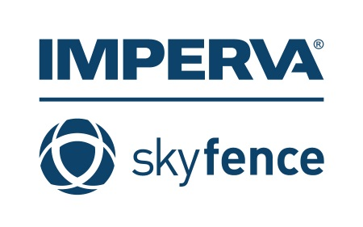
Websense and Imperva – Relationship Overview
Announced July 27, 2015
Joint interoperability enabling easier deployment for enterprise customers
Initial phase is integration of Skyfence App Discovery & Risk Catalog on the TRITON Platform

Slide 8
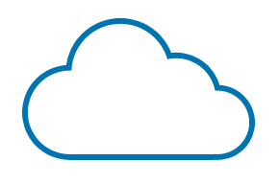
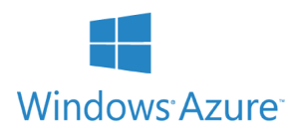
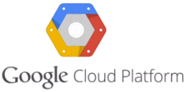
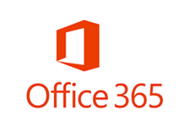
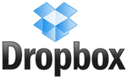
Trend Toward Cloud App Adoption and Shadow IT
Customer-facing Applications
Moving to IaaS or PaaS providers
Employee-facing Applications
are SaaS and Cloud Apps
…
Traditional Data Center
Notes:
Build-out slide
So, what’s driving the CASB market?
[Next] Well, I briefly alluded to it earlier when I mentioned that we’re starting to see more cloud apps being used in the workplace to get things done. So, it’s consistent with the general trend of entire infrastructures moving to the cloud. You’ve got Infrastructure-as-a-Service (IaaS) platforms like Amazon Web Services and Windows Azure, which are customer-facing applications that have experienced very rapid adoption. Similarly, employee-facing apps such as Office 365, Box, and Salesforce, to name a few, are cloud-based businesses that offer customers better scalability and accessibility, more cost predictability, and easier updates.
[Next] Companies like Skyfence and Imperva fill the security void left by legacy security solutions that are unable to address today’s cloud issues. Coupled with workers’ expectations (or possibly even demands) to use the cloud apps they want to be productive, IT today is witnessing a paradigm shift of sorts, where it can no longer just say “no” and cut off access to cloud apps. They’ve got to find a way to say “yes,” enabling the workforces they support to leverage the cloud apps they want to use to enhance their productivity.

Slide 9
Trend Toward Cloud App Adoption
Customer-facing Applications
Moving to IaaS or PaaS providers
Employee-facing Applications
are SaaS and Cloud Apps
…
Traditional Data Center
Notes:
Build-out slide
So, what’s driving the CASB market?
[Next] Well, I briefly alluded to it earlier when I mentioned that we’re starting to see more cloud apps being used in the workplace to get things done. So, it’s consistent with the general trend of entire infrastructures moving to the cloud. You’ve got Infrastructure-as-a-Service (IaaS) platforms like Amazon Web Services and Windows Azure, which are customer-facing applications that have experienced very rapid adoption. Similarly, employee-facing apps such as Office 365, Box, and Salesforce, to name a few, are cloud-based businesses that offer customers better scalability and accessibility, more cost predictability, and easier updates.
[Next] Companies like Skyfence and Imperva fill the security void left by legacy security solutions that are unable to address today’s cloud issues. Coupled with workers’ expectations (or possibly even demands) to use the cloud apps they want to be productive, IT today is witnessing a paradigm shift of sorts, where it can no longer just say “no” and cut off access to cloud apps. They’ve got to find a way to say “yes,” enabling the workforces they support to leverage the cloud apps they want to use to enhance their productivity.

Slide 10
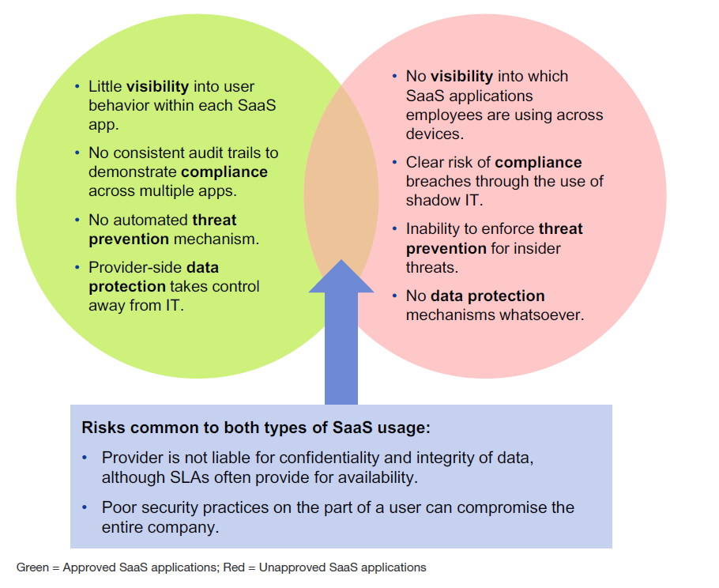
The Security Gap for SaaS Applications
“Mind the SaaS Security Gap”
Authorized Apps
Unauthorized Apps
Notes:
Even though the cloud seems to be the inevitable trend, it doesn’t come without challenges. It’s worth spending a lil time going over some of the key ones..
First is the lack of visibility into who is using what cloud apps. Many of the apps are being accessed thru workers’ personal devices, like an iPhone or iPad, that his or her employer doesn’t know about. These represent new targets for malware or hackers to go after.
Another challenge is that there’s no way to assess cloud risks and prioritize what needs to be addressed first. What may be important for one organization may not be as important for another. For instance, a healthcare company would care very much about HIPAA compliance requirements, but an oil company much less so.
A 3rd challenge is the inability to monitor and analyze all activities, particularly in real-time. Being able to monitor and apply controls on a real-time basis is absolutely essential when it comes to risk mitigation.
Fourth, for the vast majority of these cloud apps, there are no endpoint control capabilities. With the proliferation of BYOD and unmanaged devices in general, this poses a tremendous risk management headache for IT.
And, finally, cloud apps are a juicy target for hackers and insiders with malicious intent. It doesn’t have to be an outsider. Insiders with evil intentions can be just as hellbent on bringing down networks and stealing data, just as much as an outsider.

Slide 11
Cloud Access Security Brokers
Cloud
Applications
CASB
Four Pillars for CASBs
Visibility
Compliance
Threat Prevention
Data Security
Corporate employees, mobile workers and hackers

Slide 12
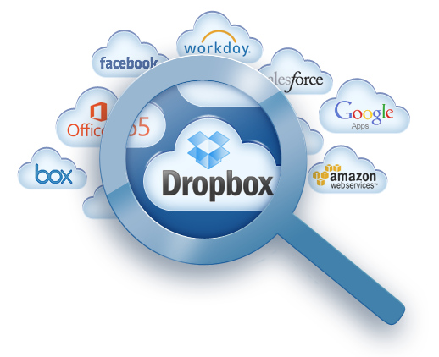
Cloud App Discovery – See What You Are Missing

Slide 13
Cloud App Discovery – See What You Are Missing
What apps are employees using?
Who are the users involved?
How much data is moving to the cloud?

Slide 14
Cloud App Discovery – See What You Are Missing
What apps are employees using?
What is the risk to my business?
What apps should I block?
Who are the users involved?
How much data is moving to the cloud?
Who is uploading files to the cloud?

Slide 15
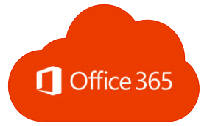
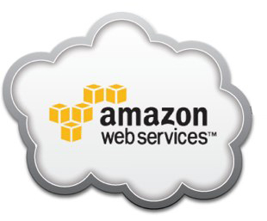
Securing Authorized Cloud Applications with Imperva Skyfence
Secure Office 365 Users
Control Collaboration and File Sharing
BYOD access control
Monitoring activity: Exchange, Skype, OneDrive, SharePoint and Yammer
Prevent Account Takeover
Data leak prevention
Prevent data leaks
Comply with regulations
Control how sensitive data is shared
Manage AWS Console Users
Salesforce.com
Monitor AWS admins
Block/control high-risk actions
Prevent account takeover
Monitor and Alert on anomalous activity
Prevent account takeover
Identify dormant accounts and access by ex-employees
Benchmark configurations
Confidential
Notes:
Build-out slide
[Next] The features we’ve developed are in direct response to what we’re seeing in the market. There have been some popular use cases that have clearly emerged head and shoulders above the rest. I think it’ll be helpful for you guys to go over some of these.
Office 365 has been gaining a lot of traction since its release a few years ago. It encompasses several MSFT services, such as Exchange, Yammer, Lync, SharePoint, OneDrive, and many others. However, there’s a common thread amongst all these services from a security standpoint. Endpoint access control (think proliferation of mobile devices and BYOD), monitoring and controlling specific actions like uploading and downloading of files, and preventing account takeovers. [Next]
The AWS Management Console also presents unique challenges. If a hacker or malicious insider were to take control of the AWS console, this is like having the keys to the kingdom. He or she could delete customer data, fire up unwanted instances, and all kinds of havoc. This underscores the need to have controls to prevent account takeovers from happening, enforcing policies to block certain high-risk activities, and even force two-factor authentication, if need be. [Next]
Another use case is that of controlling collaboration and file sharing. Box, Dropbox, and SharePoint are hugely popular yet they present problems with data security and compliance, since you don’t know who’s sharing what nor can you enforce policies that can limit uploads, downloads, shares, and the like, not to mention that PII, PCI, and HIPAA data is oftentimes within these files. [Next]
And, of course, as highlighted several times already in this webinar, discovery of line of business apps, whether sanctioned or not by IT, remains a thorny issue for many IT admins.

Slide 16
Cloud App Discovery with TRITON®

Slide 17
WE ENABLE ORGANIZATIONS TO PREVENT DATA THEFT WHILE INNOVATING IN THIS AGE OF DISRUPTIVE CHANGE.
© 2015 Websense, Inc.
Notes:
At its core, R|W is all about helping you protect your critical data amid the constantly-changing world.
We make it possible for your employees, contractors and partners to embrace innovative technologies and securely use information and applications in new, exciting ways – while STILL maintaining visibility and control of your company’s key assets.
This is what we stand for and this is what separates us from the bulk of security vendors that, frankly, are often only focused on threats and discrete aspects of an attack. Yes, these things are important, but today’s reality requires a new – data-centric – approach to security.

Slide 18
TRITON® Data-Centric Security Platform
TRITON
Unified Management
DATA Security
WEB Security
EMAIL Security
Threat Intelligence
3rd Party Feeds
Endpoint
Mobile
On-Premise
Hybrid
Cloud
Integrated Platform
Notes:
R|W created the TRITON security platform specifically to deliver this data-centric approach.
It provides a foundation for securely accessing data, the web, and email that scales from the desktop, through the enterprise network, up to the cloud.
What makes us excited about working with Imperva Skyfence is that it enables TRITON to give you visibility into what your users are doing in the cloud.
In particular, TRITON now can help you get your arms around cloud apps that your employees, contractors and others are using without your knowledge – likely going against your established security policies.

Slide 19
TRITON® Security Is Content-Aware
Who
What
Where
How
Action
Human Resources
Source Code
Business Partner
File Transfer
Confirm
Customer Service
Business Plans
Dropbox
Web
Block
Marketing
Personal Data
Business Partner
Instant Messaging
Notify
Finance
M&A Plans
Facebook
Peer-to-Peer
Remove
Accounting
Employee Salary
China
Email
Quarantine
Sales
Financial Report
Spyware Site
Print
Audit
Legal
Customer Records
Removable Media
File Copy
Encryption
Technical Support
Technical Doc
Competitor
Print Screen
Block
Engineering
Competitive Info
Analyst
Copy/Paste
Notify
Notes:
TRITON is able to give you this visibility because it looks at data from the perspective of:
who is trying to access it,
where they are trying to move it,
and via what protocol they are using.
You use TRITON to express your Corporate Security Policies and automatically take the appropriate action in each context.

Slide 20
Giving IT Visibility Into Cloud App Usage
DISCOVER use of unsanctioned apps
Find cloud apps that have been provisioned by employees (“Shadow IT”)
UNDERSTAND RISK of each application
IDENTIFY USERS who engage in risky cloud app behavior
Raise the Security IQ of organization
Protect data everywhere
Notes:
The result is that you can quickly discover which cloud apps are being used illicitly, and understand the risks that each app might entail.
In addition, you can who within your organization is using these apps, so that you can educate them on alternatives or potentially enforce limits on access to keep your data safe.

Slide 21
Giving IT Visibility Into Cloud App Usage
DISCOVER use of unsanctioned apps
Find cloud apps that have been provisioned by employees (“Shadow IT”)
UNDERSTAND RISK of each application
IDENTIFY USERS who engage in risky cloud app behavior
Raise the Security IQ of organization
Protect data everywhere
Bottom Line:
Make smarter decisions about Cloud App Usage and Enforce your Security Policies
Notes:
Ultimately, it’s about giving you the information you need to make decisions about cloud app usage and ensure that your security policies are being followed.

Slide 22
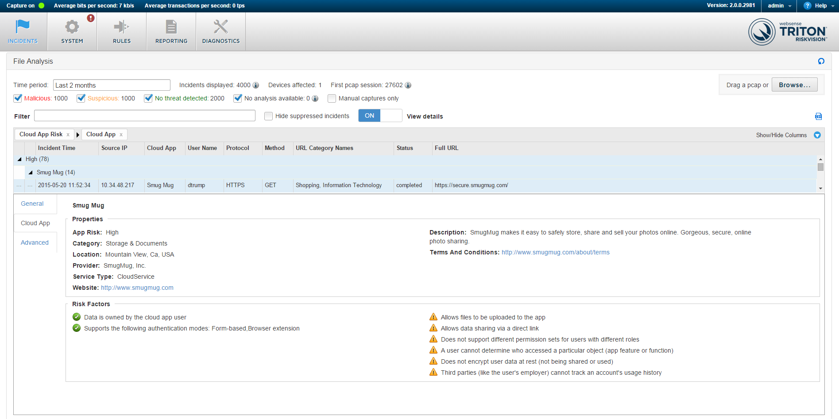
What
Who
Where
Go Past IT
Go Past IT
https://gopastit.com
Go Past IT, Inc.
RISKVISION
Go Past IT
https://gopastit.com/about/terms
Go Past IT, Inc.
https://gopastit.com
Notes:
Let’s see an example of how TRITON RiskVision – one of the solutions powered by the TRITON platform -- displays risk information about cloud apps.
In this screenshot, we can see that a particular user – let’s call him “David Trump (dtrump)” -- has accessed a HIGH-risk cloud application that is an online storage site (photos).

Slide 23
Go Past IT
Go Past IT
https://gopastit.com
Go Past IT, Inc.
Level of Risk
RISKVISION
Go Past IT
https://gopastit.com/about/terms
Go Past IT, Inc.
https://gopastit.com
Mitigating Factors
Potential Problems
Notes:
In addition to telling you what and who, RiskVision also rates the overall risk of the app and summarizes key elements of the app that either reduce or increase risk.
With this information, your security personnel can determine whether a conversation with the user might be in order to suggest an alternative to this particular app.

Slide 24
Users to Examine
Go Past IT
Most-Prevalent Cloud Apps
Notes:
In addition, RiskVision makes it easy for your teams to see at a glance which high-risk cloud apps are being used.
And, it shows the top users of those apps so that you can focus your education and remediation efforts.

Slide 25
Summary
Two market leaders working together to raise the bar in data security
Certifying interoperability of respective platforms
TRITON® is embedding Skyfence Cloud App Discovery Catalog
Delivered across Raytheon|Websense solutions:
TRITON RiskVision
TRITON APX
Extends visibility and control to Cloud Apps and Shadow IT
Notes:
Ultimately, what we’re talking about here today is a new way for you to raise the bar in data security.
We’ve made sure that our respective products work seamlessly together so that Imperva customers can immediately add Raytheon|Websense products and vice versa.
And, we very excited to be embedding the Skyfence Cloud App Discovery Catalog into TRITON so that it can be used across our platform to extend your visibility and control to Cloud Apps and Shadow IT.

Slide 26
Summary
Two market leaders working together to raise the bar in data security
Certifying interoperability of respective platforms
TRITON® is embedding Skyfence Cloud App Discovery Catalog
Delivered across Raytheon|Websense solutions:
TRITON RiskVision
TRITON APX
Extends visibility and control to Cloud Apps and Shadow IT
Bottom Line:
Prevent Potential Data Theft by Identifying Usage of High-Risk Cloud Apps
Notes:
In the end, Imperva Skyfence and Raytheon|Websense want to empower you with the information and tools you need to prevent data theft that can come from the use of inappropriate cloud apps.

Slide 27
Questions

Slide 28
Free Demo or Trial
Imperva Skyfence Cloud Gateway
Request a personalized demo or free trial of the Skyfence Cloud Gateway.
https://www.skyfence.com/free-demo-or-trial
Free Trial of Raytheon|Websense TRITON
www.websense.com/freetrials

Slide 29
Questions
Frank Cabri
VP Marketing, Imperva Skyfence
Imperva
frank.cabri@imperva.com
Jim Fulton
Senior Director, Product Marketing
Raytheon|Websense
jfulton@websense.com

