Slide 1
Social Media Acceptable Use Policy
Insert Company Name Here
Notes:
Template Notes
This template is intended to provide sample content for employee social media acceptable use training . It describes social media risks, company policy and employee education.
This template is intended to serve only as sample content and does not represent legal advice. Consult with your attorney for legal advice.
Although any portion of this template may be modified, red text indicates items that require specific customization
This content may copied and pasted into your own documents, or you can remove the background watermark by adjusting background settings (change to solid fill - white).

Slide 2
Social Media Policy Overview
[Insert Company Name] recognizes business and personal reasons to use Social Media.
Social Media allowed for [designated/all employees] within acceptable use guidelines
Productivity
Inappropriate content
Data confidentiality
Malware and online crime

Slide 3
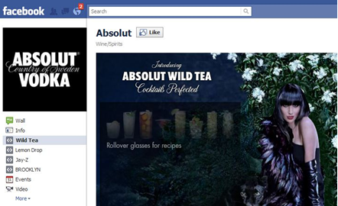
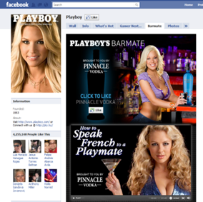
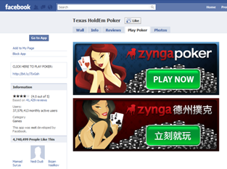
Inappropriate Content
Social Media can contain inappropriate workplace content - nudity, violence, abused drugs, gambling, etc.
Do not access at work or using company resources
Same policy applies to all Web sites – not just social media.
For more detailed information and a list of inappropriate content types see [insert reference here].

Slide 4
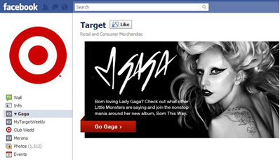
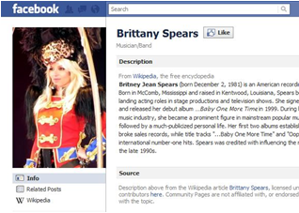
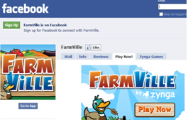
Productivity
Limited (xx minute daily quota) access to non-business social media allowed
Your responsibility: make sure personal business does not affect work quality or productivity
Same policy applies to all Web sites – not just social media
For more detailed information and a list of non-business content types, see [insert reference here].

Slide 5
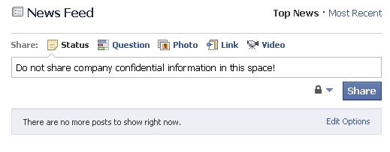
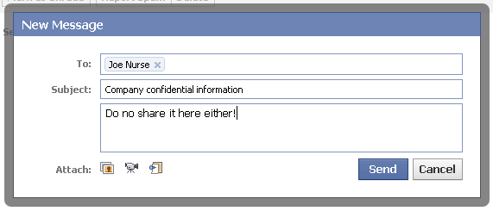
Data Confidentiality
Social media promotes culture of sharing…be careful! Don’t publish confidential information
[Insert company specific confidential data examples ]
Do not comment on stock price
Employees responsible for content they publish
For more detailed confidentiality guidelines see [insert reference here].

Slide 6
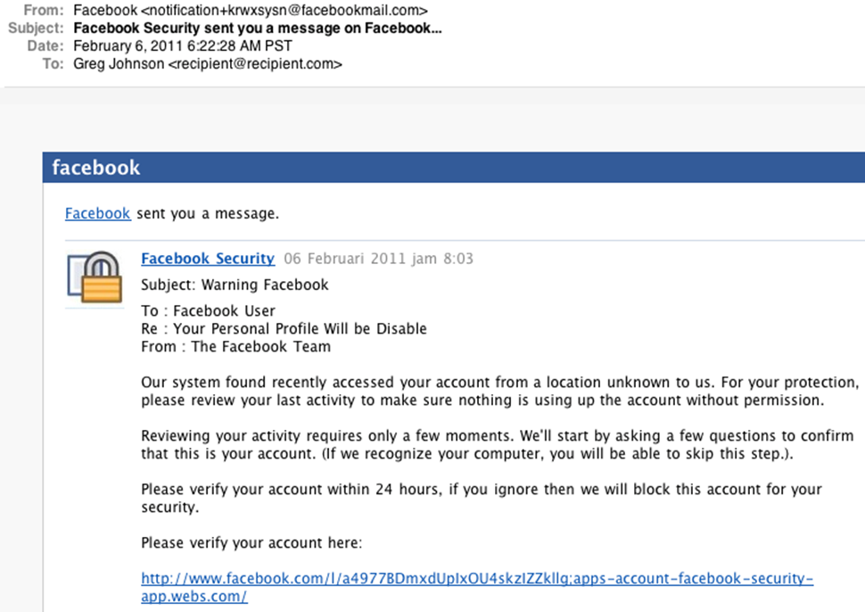
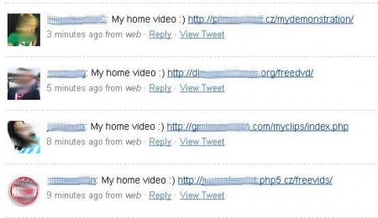
Malware and Online Crime Prevention
Social media commonly delivers malware and other criminal schemes
Don’t use same passwords for social media and business
Do not click links or download software from people you do not know
Use a security application (www.defensio.com) for personal and company social media pages
Configure accounts to encrypt communications whenever possible

Slide 7
Summary
Policy can’t cover every situation. When using social media – use common sense!
Be considerate of others when deciding what content is appropriate
Make sure you are getting your job done
If uncertain regarding confidentiality - don’t post information
If anything looks suspicious - close your browser
Review full acceptable use policy at [Insert Reference]

